Slide 1
EART 28202 : Structural Geology
Class 6 : Fracturing and the emplacement of minor intrusions
Notes:
In the notes panes to these slides there are numerous references (figure credits and further reading). If the reference is incomplete it refers to the references stated in the reading list on the last slide
With regard to figures in this PowerPoint file, many will be subject to copyright restrictions. I don’t care about you using any of the figures/photos that are mine (Steve Covey-Crump), although a credit would be nice, but take care to comply with copyright restrictions if you reuse any that are not

Slide 2
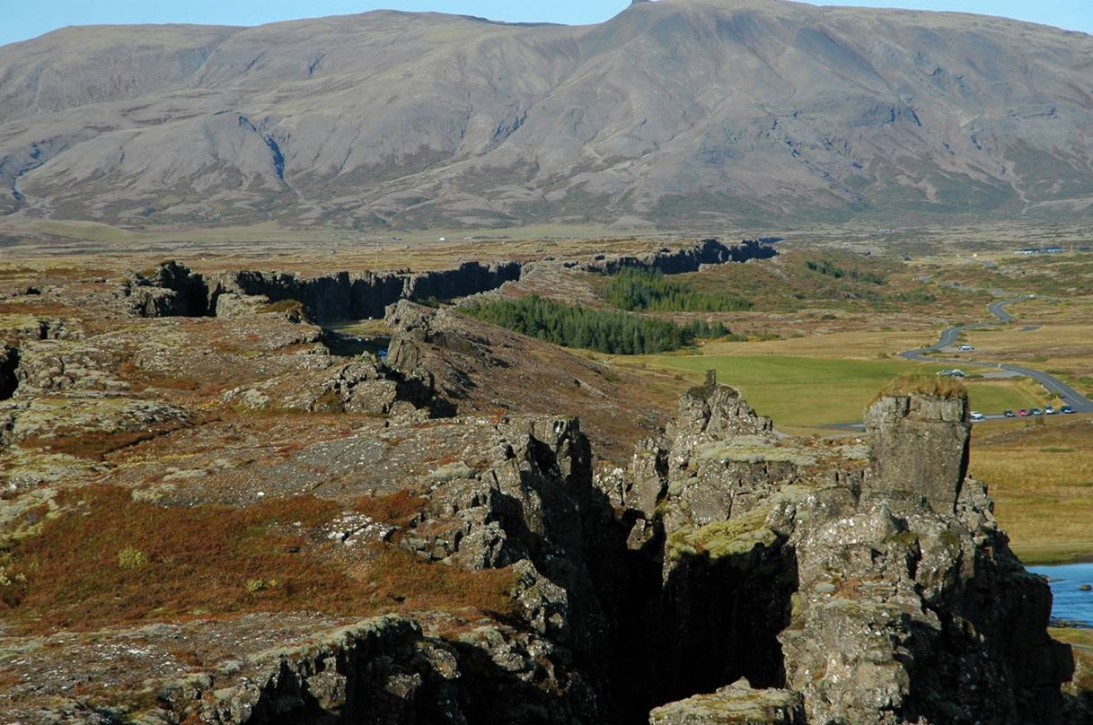
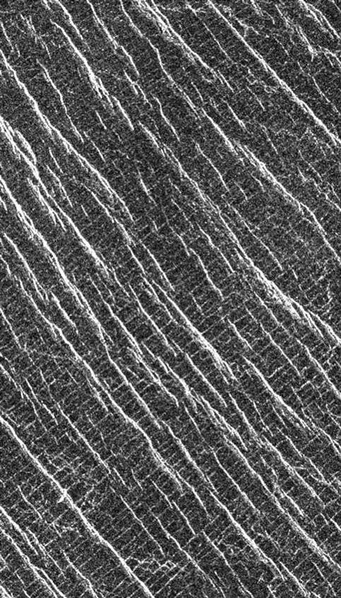
Fractures
Fractures appear almost everywhere at the surface of the Earth, ranging in size from microcracks within individual grains to mid-ocean ridge segments and transform faults that form parts of the boundaries of lithospheric plates
Fractures are also a significant feature on the surfaces of other planetary bodies
Fissures at Thingvellir, Iceland, along the rift axis between the Eurasian and Laurentian plates
Orthogonal fractures, Lakshmi, Venus
Notes:
Photo left (from Fossen, p.129). This fissure is an open extension fracture, but the vertical displacement (right hand side down) suggests a connection with underlying normal faults
Image right (from photojournal.jpl.nasa.gov/catalog/pia00085): Magellan radar image of the Lakshmi region at 30°N and 333.3°E between Sedna Planitia and Guinevere Planitia, west of Eistla Regio, Venus. This lava plain contains two sets of fractures at 90° to each other. The fainter and older fractures (NE/SW) are evenly spaced at ~1.0 km. The bright and younger fractures (NW/SE) are more irregular in shape and shorter in length than the NE/SW fractures. These particular fracture sets imply extensional deformation of the surface of Venus in this region. For further details, see Solomon et al., 1991, Science 252: 297-312, https://doi.org/10.1126/science.252.5003.297; Banerdt & Sammis, 1992, Journal of Geophysical Research 97: 16149-16166, https://doi.org/10.1029/92JE01892

Slide 3
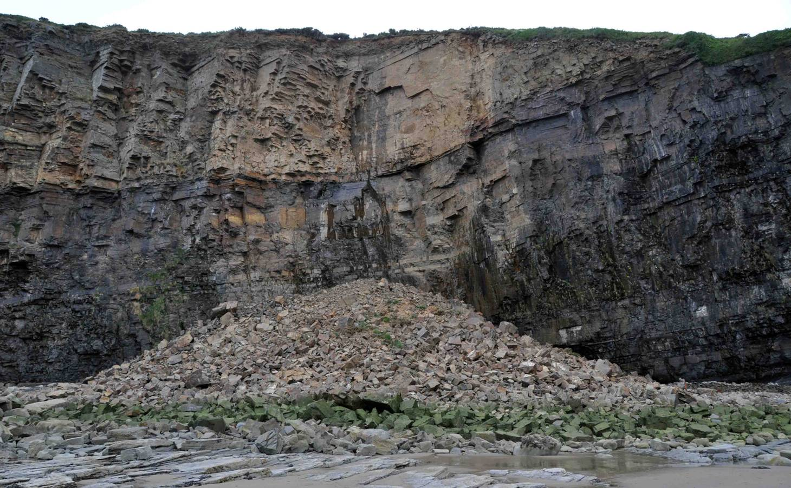
The importance of fractures
For the hydrologist, and petroleum/mining geologist the influence of fractures on fluid flow is critical, while for the engineering geologist their influence on substrate and slope stability is of key importance
Notes:
Photo (Steve Covey-Crump): the cliff section at Telpyn Point, Amroth, Pembrokeshire. The collapse of the cliff collapse, thanks to intersecting joints, occurred sometime between June 2009 and June 2010 and buried a superb exposure of the Amroth Granule Bed that we used to visit on a sedimentology techniques field course

Slide 4
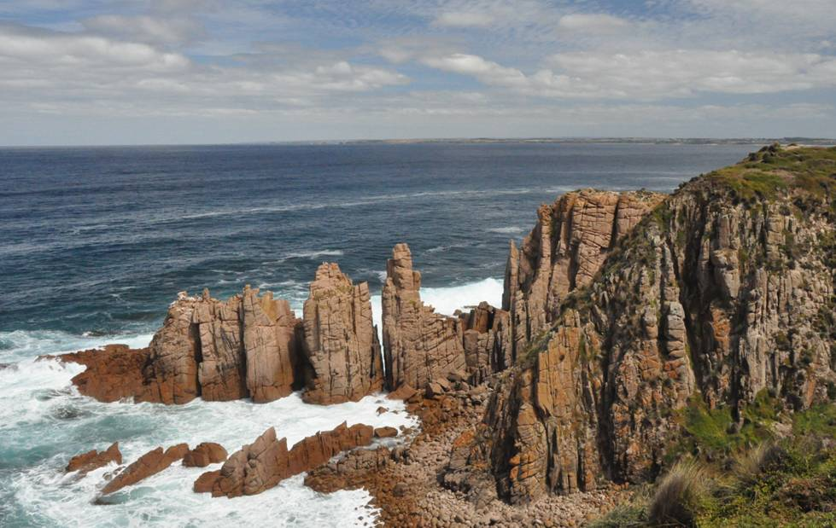
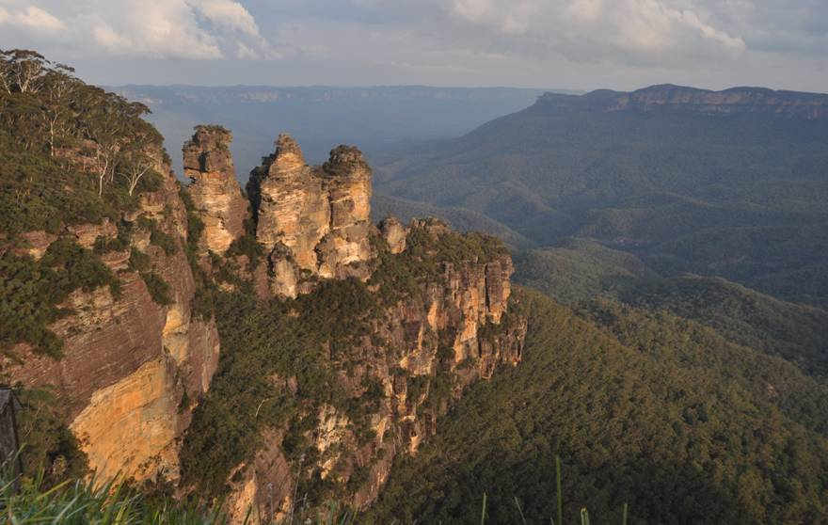
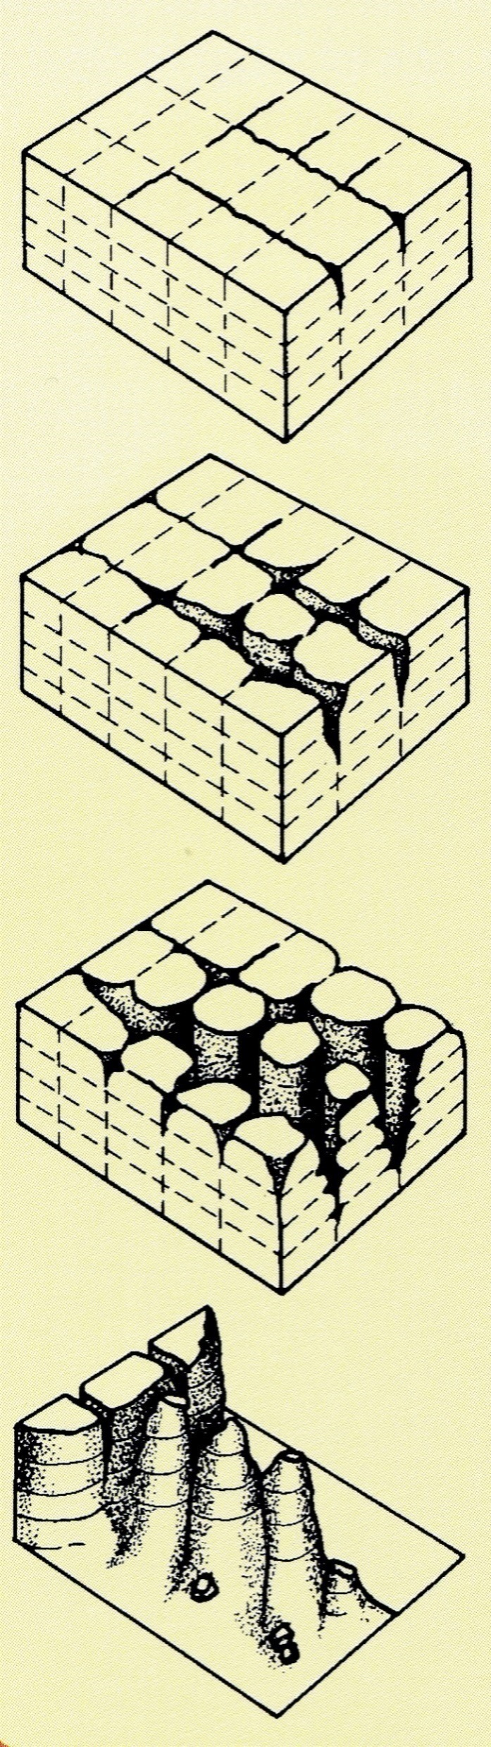
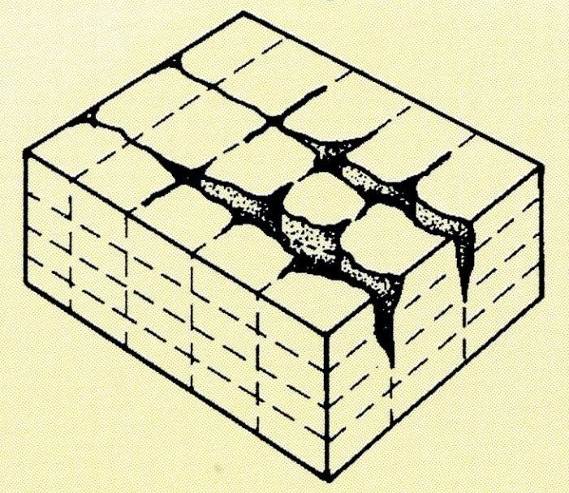
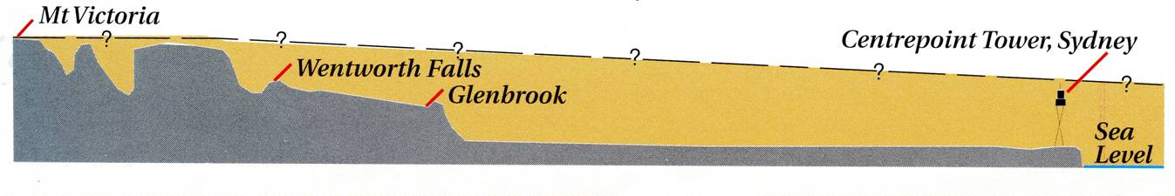
The importance of fractures 2
. . . and fractures exert a profound influence on landscape evolution
Blue Mountains, New South Wales
Fracture-controlled coastal erosion
10 km
Blue Mountains
eroded
W
E
Notes:
Photo top left (Steve Covey-Crump): the granites of Cape Woolamai, Phillip Island, SE Australia
Photo right (Steve Covey-Crump): the Three Sisters, Katoomba, Blue Mountains, Australia (located near Wentworth Falls on the section shown at the bottom of the slide). The canyonlands of the Blue Mountains reflect joint-controlled erosion of Permo-Triassic fluvial sandstones. One of several variants of the aboriginal legend describing how the Three Sisters were formed runs as follows. There were once three sisters named Meehni, Wimlah and Gunnedoo who lived with the Gundungurra people in the Jamison Valley. The sisters were in love with three brothers from the neighbouring Dharruk people, but marriage to them was forbidden by tribal law. The brothers decided to take the sisters by force. In the ensuing war, the Kuradjuri (clever man) of the Gundungurra people turned the sisters into stone, intending to restore them after the danger had passed. However, he was killed in the battle and since that time, no-one has been able to break the spell
Four small diagrams illustrating the formation of the Three Sisters from Pickett & Alder, 1997, Layers of Time: the Blue Mountains and their Geology, New South Wales Department of Mineral Resources, p.19, https://search.geoscience.nsw.gov.au/product/1056
Diagram bottom right from Pickett & Alder, 1997, Layers of Time: the Blue Mountains and their Geology, New South Wales Department of Mineral Resources, p.13, https://search.geoscience.nsw.gov.au/product/1056

Slide 5
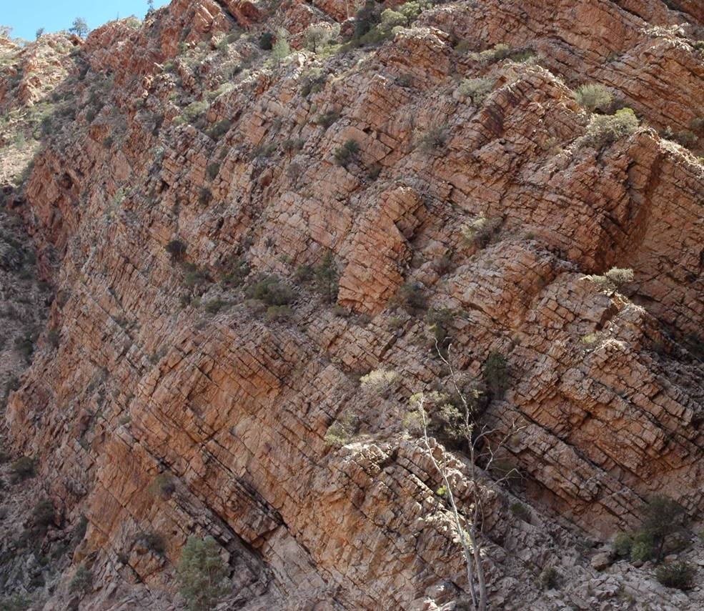
Plan of action
In this class (Class 6) we will consider fractures across which displacements parallel to the fracture surface are too small to be measurable at the exposure scale:
  Joints and shear fractures (the distinction is fuzzy)
  Veins/hypabyssal igneous intrusions
  Polygonal fracture sets
In the next class (Class 7) we will consider fractures across which the displacement parallel to the fracture surface is measurable at the exposure scale, that is, we will consider faults
Minor fractures of the kind that we consider in this class are generally poorly described by students in the field. Given their economic significance, this cannot be good
Notes:
Just about anyone who does any geological fieldwork will encounter many of the features that I cover in this class. Don’t ignore them!
Photo (Steve Covey-Crump): heavily jointed Rawnsley Quartzite, Brachina Gorge, South Australia

Slide 6
Fracture types and formation

Slide 7
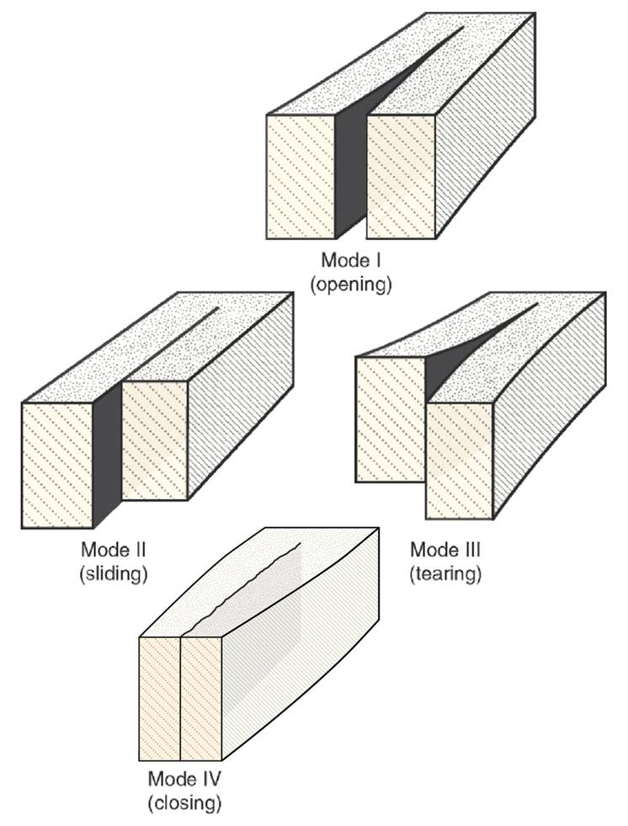
Classification of fractures
A fracture is a surface across which there is a discontinuity in displacement and mechanical properties. Although described as surfaces because they are very narrow in one dimension compared with the other two, at some scale they always have thickness
Fractures are classified by the displacement across the fracture surface during their formation
Extension fractures (Mode I): displacement normal to the fracture walls in an opening sense
Shear fractures (Mode II, Mode III): displacement parallel to the fracture walls – the two modes distinguish two orthogonal slip directions
Contraction fractures (Mode IV): displacement normal to the fracture walls in a closing sense (anticracks)
Hybrid fractures (mixed mode): fractures that are some combination of the other types (usually extension + shear OR compression + shear)
Notes:
Figure from Fossen, p.127 (the Mode IV figure is an erratum to the figure published in the 1st edition of his book, but this correction seems to have been overlooked when producing the 2nd edition – the figure is correctly shown here but is not in the 2nd edition of the book)

Slide 8
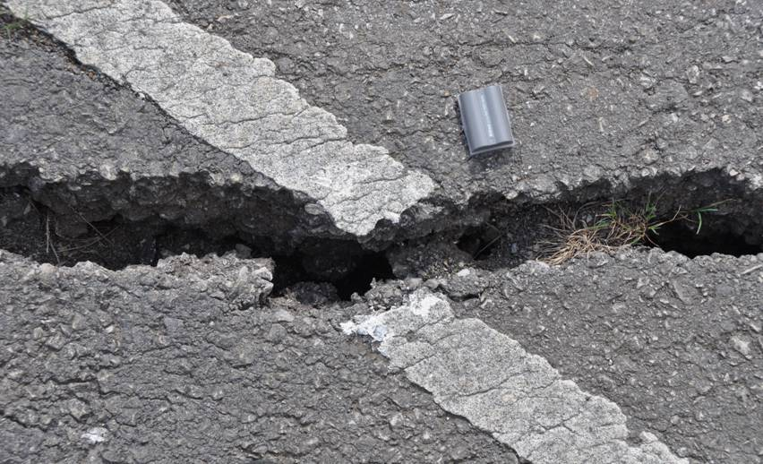
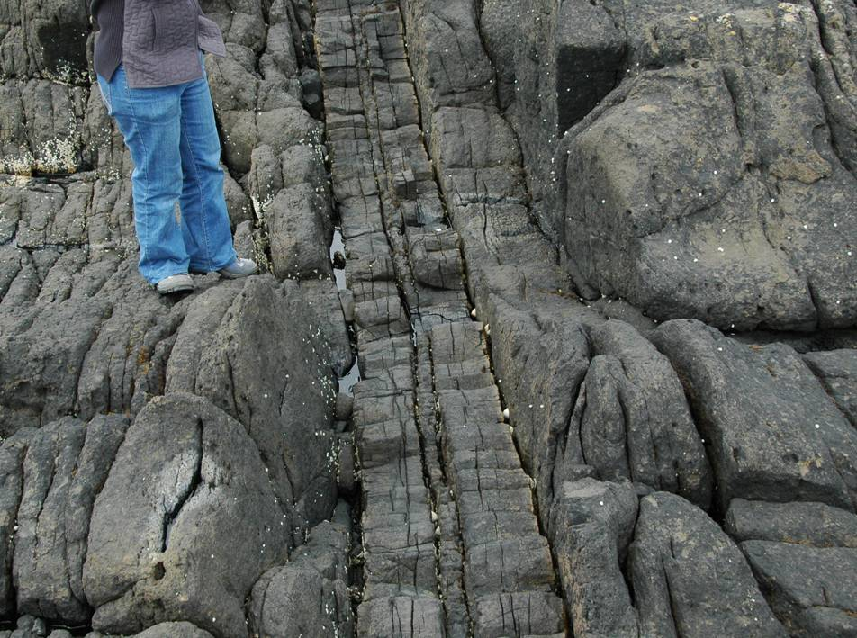
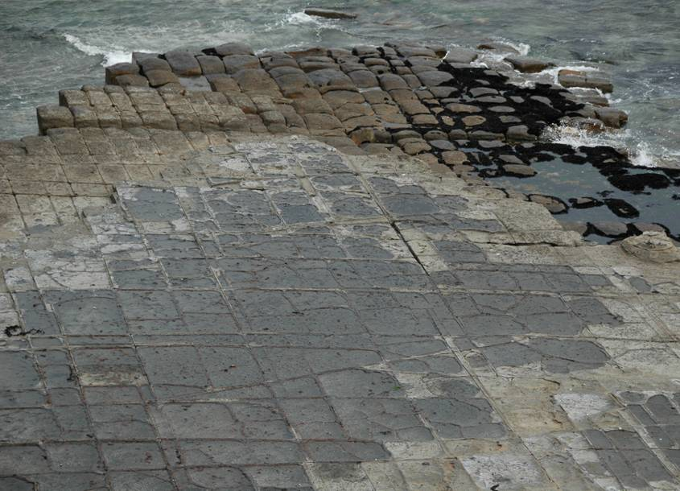
Extension fractures
Extension fractures filled with air or fluid are fissures. Veins are mineral-filled extension fractures; dykes are magma-filled extension fractures; joints are extension fractures with a very small opening displacement and no macroscopically observable fracture-parallel displacement
Fissure (top), dyke (left), joints (above)
Notes:
Photo top right (Steve Covey-Crump): fissure in the road at Mam Tor, Derbyshire. Note that the offset road marker line indicates that it is a pure extension fracture (displacement vector normal to the fracture walls)
Photo bottom left (Steve Covey-Crump): Cenozoic dyke at the Aird of Sleat, Skye (near Tarskavaig). Note its composite nature (thin central dyke intruding a wider earlier dyke). Note also the discoloured chilled margins on the outer contacts of the earlier wider dyke
Photo bottom right (Steve Covey-Crump): orthogonal joint sets, Eaglehawk Neck, Tasmania

Slide 9
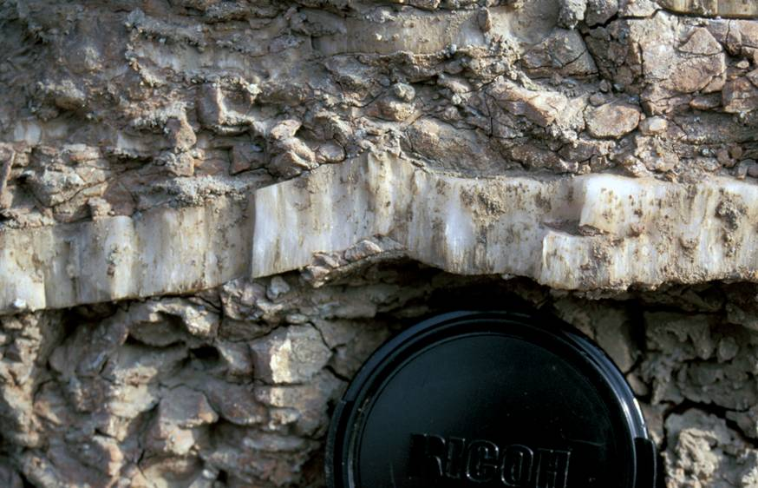
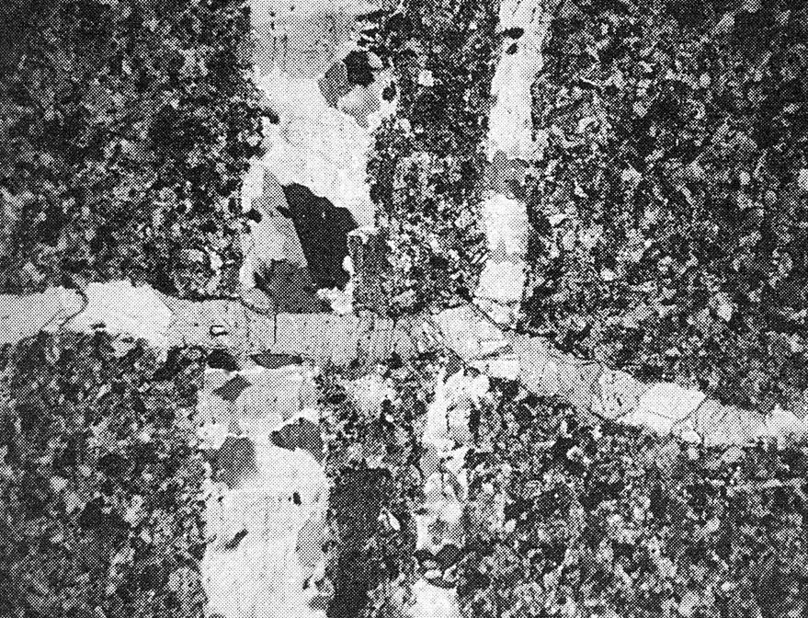
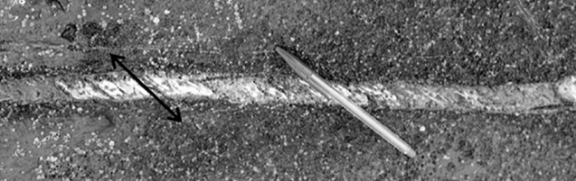
Extension fractures but strictly hybrid
Although fissures, veins, dykes, and joints are commonly viewed as extension fractures, small fracture-parallel offsets, seen in thin section, or in the growth of mineral fibres oblique to the fracture margins, often implies a hybrid character
Normal and oblique mineral fibres
The hybrid character of the left-right trending calcite vein is indicated by the way that it offsets the up-down trending quartz veins
100µm
Notes:
Photo top right (Steve Covey-Crump): gypsum (satinspar) filled extension fracture, Aust Cliff, under the Severn road bridge. The opening direction is indicated by the fibres in the vein
Photo middle right (from Belayneh & Cosgrove, 2010, Journal of Structural Geology 32: 192-201, https://doi.org/10.1016/j.jsg.2009.11.010): calcite-filled hybrid fracture with opening direction indicated by the fibres (sinistral transtension), Somerset coast near Lilstock. I have put the red lazy arrows on the photo to indicate the sense of displacement indicated by the fibres. The fibres grow parallel to σ₃ – see Class 4 Slide 37. If I was being really accurate, I should say the fibres grow parallel with e₁, the maximum extension direction, that is, in my first statement I am implicitly assuming that σ₃ and e₁ are parallel.
Photomicrograph bottom left (from Price & Cosgrove, p.43): cross-cutting veins seen in thin section. Note that the ~10 µm dextral shear displacement across the later vein would not be visible in the field

Slide 10
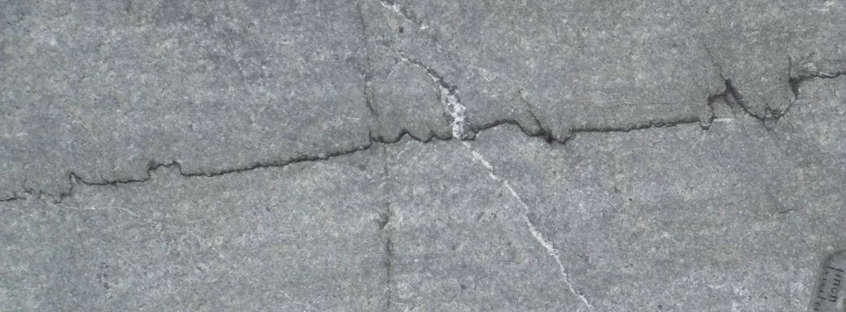
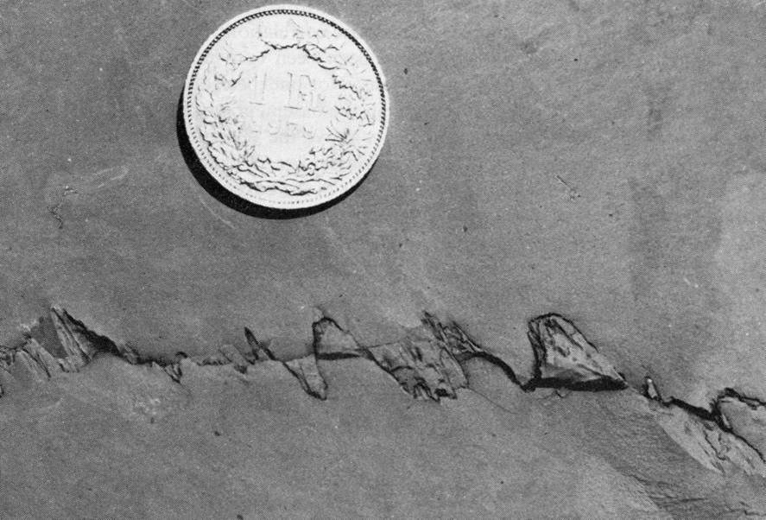
Contraction fractures (for completeness)
stylolite (left); slickolite (below)
Contraction fractures include stylolites. These irregular surfaces have interlocking ‘teeth’ oriented normal to the surface – this implies ‘closing’ in this direction
Stylolites with teeth oblique to the surface (properly described as slickolites) indicate that these contractional features can also be of hybrid character
Notes:
For a comprehensive review of the geometry of stylolites, how they form, and what may be deduced from them about the deformation conditions, see Toussaint et al., 2018, Journal of Structural Geology 114: 163-195, https://doi.org/10.1016/j.jsg.2018.05.003. Of particular interest is the fact that the roughness of stylolites can be used to infer stresses at the time they were formed (e.g., Rolland et al., 2014, International Journal of Rock Mechanics & Mining Sciences 67: 212–225, http://dx.doi.org/10.1016/j.ijrmms.2013.08.021; Beaudoin et al., 2016, Tectonics 35: 1687–1712, https://doi.org/10.1002/2016TC004128). This kind of stress analysis can, in principle, be used to place constraints on the growth of folds (e.g., Lacombe et al., 2021, Solid Earth 12, 2145–2157, https://doi.org/10.5194/se-12-2145-2021)
Stylolites have commonly been treated as anticracks (see Fletcher & Pollard, 1981, Geology 9: 419-424, https://doi.org/10.1130/0091-7613(1981)9<419:AMFPSS>2.0.CO;2). The idea is that dissolution on a stylolite produces an elliptical hole; as this hole closes under compressive stress, the stresses around the surface of the hole become more strongly compressive, thereby driving further dissolution; the stresses around the hole are taken simply as the reverse of the stresses around an elliptical hole that is subjected to tensile rather than compressive stresses – hence the term ‘anticrack’. More recent analyses of the stresses around stylolites, however, suggest that these are not well described using the anticrack model but rather that stylolites are better described as elliptical inclusions inside which some volume reduction has occurred. The analysis of the stress around such inclusions shows that in some regions around the inclusion, the stresses are indeed strongly compressive but in other regions they are strongly tensile and/or involve a significant component of shear. This latter analysis does a much better job at accounting for the extension and shear fractures that are commonly seen around stylolites (for a discussion, see Aharanov & Karcz, 2019, Journal of Structural Geology 118: 299-307, https://doi.org/10.1016/j.jsg.2018.11.002)
Establishing the nature of the stress field around stylolites is not as arcane as it might seem. Petroleum and aquifer geologists working in carbonate reservoirs are strongly interested in stylolites because of their potential impact on fluid permeability (e.g., see Nelson, 1981, American Association of Petroleum Geologists Bulletin 65: 2417-2425, https://doi.org/10.1306/03B599AE-16D1-11D7-8645000102C1865D) – insoluble residues along stylolitic surfaces potentially impede the flow of fluids through the reservoir (although this effect on permeability may not always be as large as is generally thought – see Heap et al., 2014, Geology 42: 51-54, https://doi.org/10.1130/G34900.1). If extension fractures can form around stylolites, their effect on permeability is potentially still less significant
Slickolites are commonly found around flexural slip folds
Photo top (Steve Covey-Crump): stylolite from Carboniferous limestones at West Angle Bay, Pembrokeshire
Photo bottom (from Ramsay & Huber, p.656): slickolite from Holderbank, north Switzerland. The slip sense shown by the lazy arrows in red follows from the direction of maximum compression

Slide 11
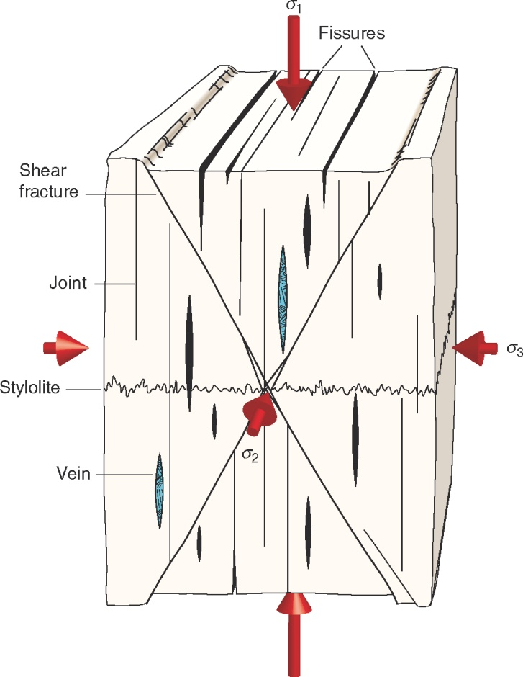
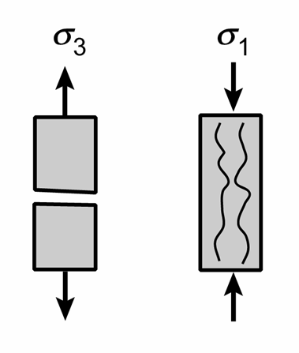
Relationship with the principal stress directions
Extension fractures open parallel to the direction of minimum compressive stress, σ₃ (direction of least resistance), and propagate within the σ₁ - σ₂ plane
Under tensile conditions this means that the opening direction is parallel to the stretching direction
Contraction fractures form perpendicular to the direction of maximum compressive stress, σ₁ (the σ₂ - σ₃ plane)
Shear fractures form at an angle of less than 45° to σ₁ and ideally contain σ₂
Notes:
To be strictly accurate, what we see when observing fractures is strain not stress and so in making the points on this slide, we are implicitly assuming that the axes of stress and strain coincide. This is OK in this class because we are considering fractures with very small displacements across them
Figure left adapted by Steve Covey-Crump from Jaeger et al., 2007, Fundamentals of Rock Mechanics (4th edition), p.88
Figure right from Fossen, p.126

Slide 12
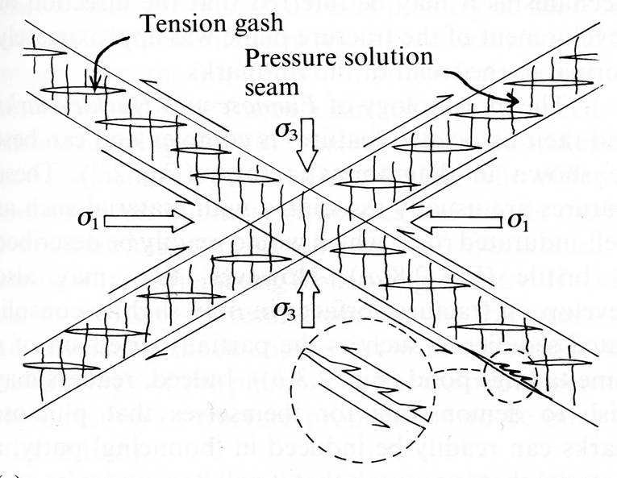
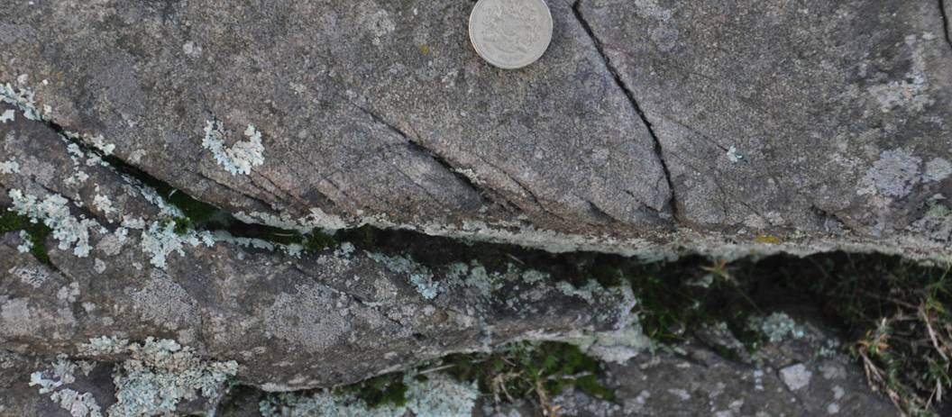
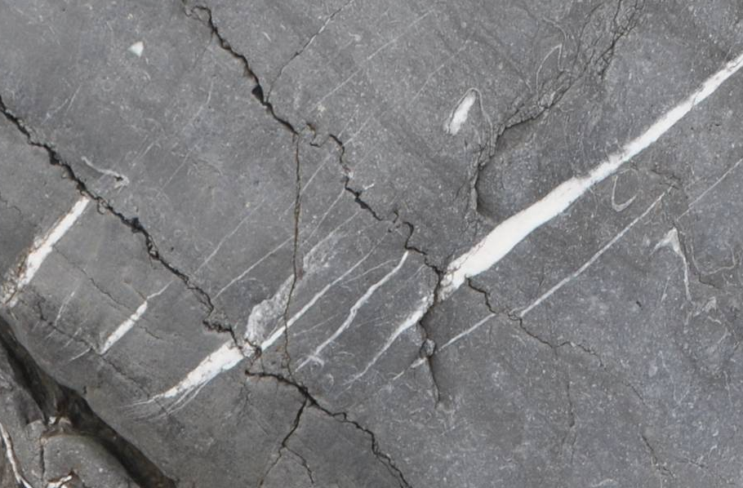
Shear fractures (in nature)
When displacements are small, shear displacement is implied by en échelon arrays of tension gashes and pinnate fractures
σ₃
σ₁
Pinnate fractures
These arrays often come in conjugate pairs at 40° - 60° to each other
The extensional nature of the gashes, and the contractional nature of the stylolites oriented normal to them → direction of maximum compressive stress (σ₁ ) bisects the acute angle between the conjugate pair and σ₃ bisects the obtuse angle
σ₁
σ₃
Notes:
Photo top left (Steve Covey-Crump): pinnate fractures implying dextral shear displacement, Charnwood Forest, Leicestershire. Pinnate fractures are also known as feather fractures because their orientation indicates sense of movement as if they were flight feathers on an arrow. Note that they are in the same orientation as tension gashes
Figure top right from Price & Cosgrove, p.45
Photo bottom left (Steve Covey-Crump): tension gashes and stylolites, Carboniferous limestones, West Angle Bay, Pembrokeshire. Note that the tension gashes are oriented normal to the stylolites implying that individually they are extension fractures (assuming that the stylolites and tension gashes formed at the same time). However, their en échelon arrangement implies a sinistral sense of shear for the array as a whole

Slide 13
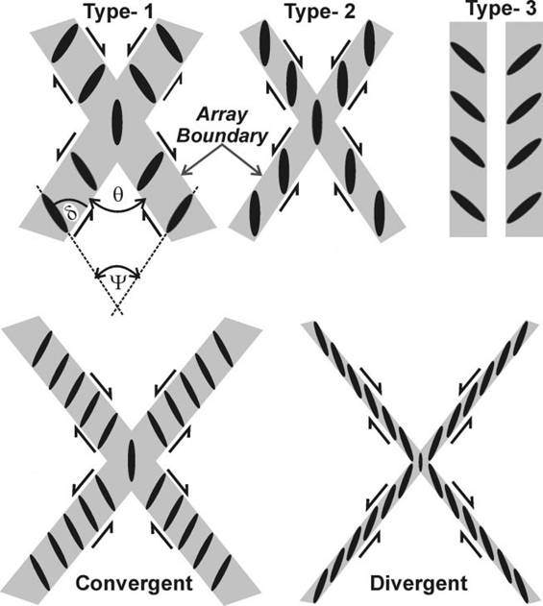
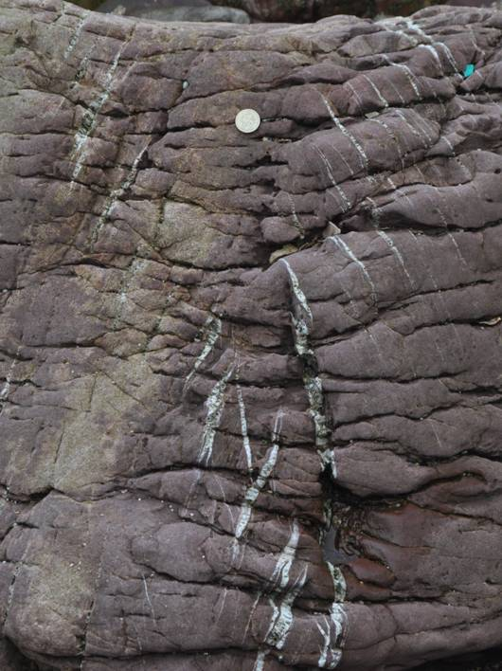
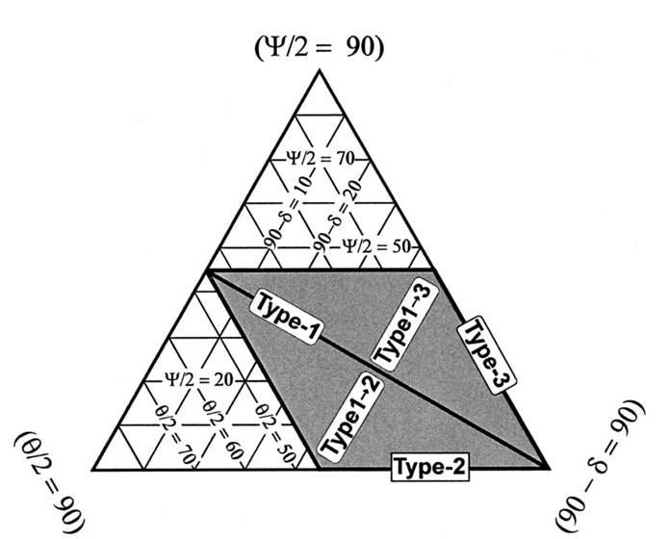
Shear fractures (in nature) 2
In real conjugate vein arrays, the orientation of the veins deviates from the ideal arrangement in which the veins in each array are parallel to each other and to the bisecting plane (Type 2)
The geometry of arrays may be defined in terms of three angles, θ, ψ, and δ, where for convergent arrays
(θ / 2) + ( 90° - δ ) + (ψ / 2) = 90°
All natural arrays have θ ≤ 90° and ψ ≤ 90° and so lie within the shaded area on the triangular diagram right
No natural divergent arrays have yet been reported
Convergent array of tension gashes
Notes:
For further details on the classification of conjugate vein arrays, see Srivastava, 2000, Journal of Structural Geology 22: 713-722, https://doi.org/10.1016/S0191-8141(00)00005-5. Note that Type 3 (θ = 0°) is simply specified as an end-member type – no conjugate array can have this geometry because it implies the opposite sense of shearing on two arrays that are conjugate and yet parallel to each other
For a brief discussion of theories on the formation of conjugate vein arrays, see Bons et al., 2012, Journal of Structural Geology 43: 33-62, https://doi.org/10.1016/j.jsg.2012.07.005
Figures top and bottom right from Srivastava, 2000, Journal of Structural Geology 22: 713-722, , https://doi.org/10.1016/S0191-8141(00)00005-5
Photo bottom left (Steve Covey-Crump): convergent conjugate vein array, Freshwater West, Pembrokeshire. Note the pressure solution cleavage that is oriented left-right on the photo

Slide 14
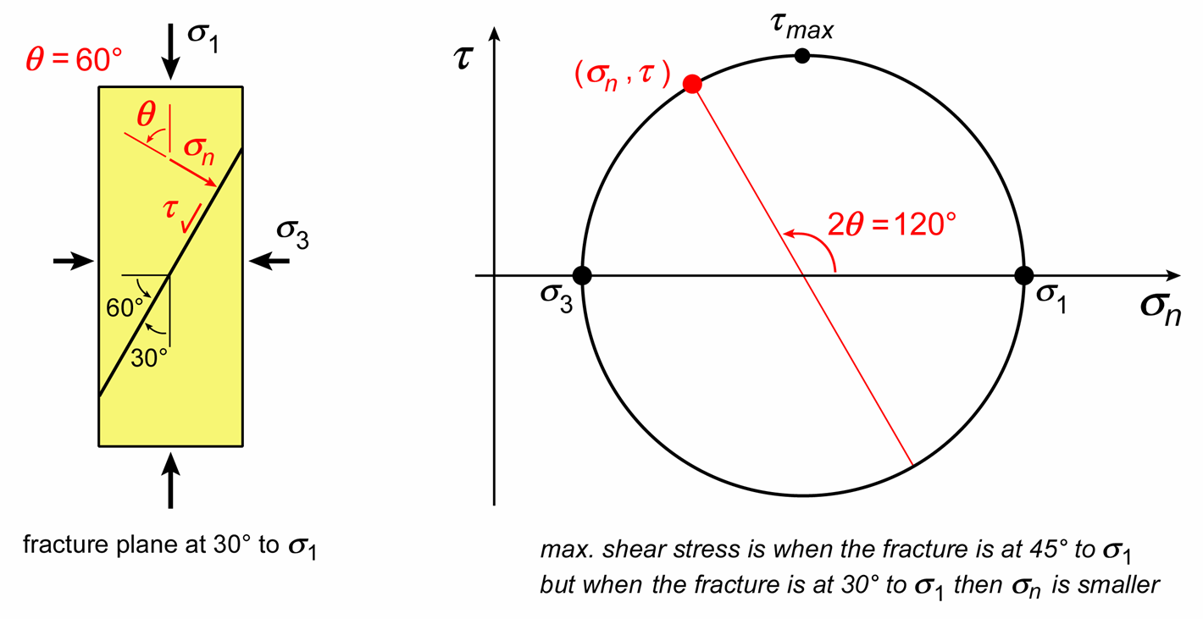
Shear fractures (in experiments)
Samples deformed experimentally in axial compression at elevated confining pressure form shear fractures at 20°- 30° to the maximum compressive stress
In such tests, σ₁ is axial stress and
σ₂ = σ₃ is the confining pressure, and so the normal stress and shear stress on the fracture plane may be obtained from the angle that the fracture plane makes with σ₁ using a Mohr diagram
Why don’t fractures form at the orientation for which the shear stress on the fracture plane is greatest = 45° to σ₁ (2θ = 90°)? On a fracture plane at ~ 30° to σ₁ (2θ = 120°), although the shear stress is slightly smaller, the normal stress is much smaller
Notes:
In Ex.1 of the Stress practical last week, we calculated the normal stress and shear stress on a plane oriented 30° anticlockwise to σ₁; on the figure on this slide this exercise is solved for a plane oriented 30° clockwise to σ₁. Remember from Ex.1 of the Stress practical last week that 2θ is 120° for a shear plane formed at 30° to σ₁ because θ is the angle between σ₁ and the normal to the plane (= 60°)
The normal stress acts to push the two sides of the fracture together. Since fracturing involves a volume increase, the normal stress on the fracture plane acts to suppress fracturing (fracturing becomes easier as normal stress is decreased)
Figure by Steve Covey-Crump

Slide 15
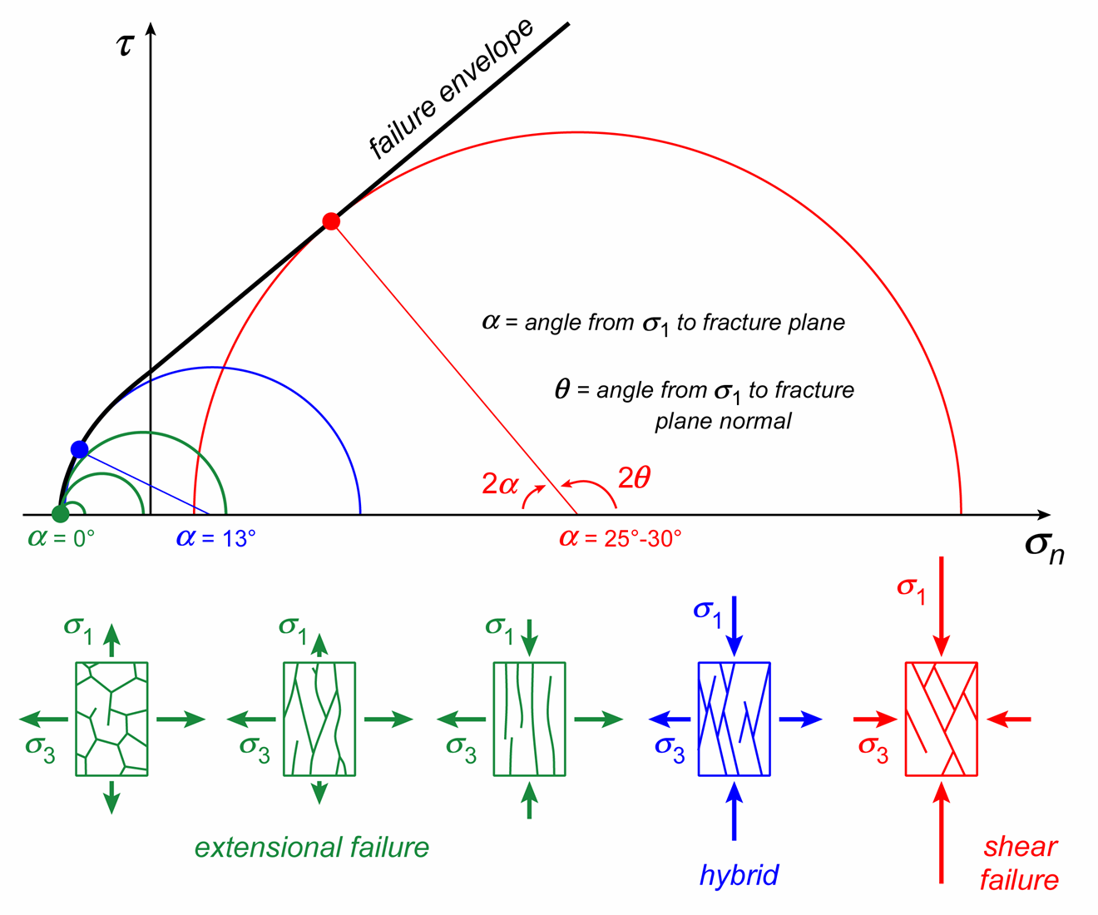
The effect of confining pressure on fracture
Plotting the normal stress (σ_{n}) and shear stress (τ ) on the fracture plane at failure for samples deformed at different confining pressures, defines a failure envelope on a Mohr diagram
Experiments show a continuous gradation with increasing confining pressure between
Extension fractures with fracture planes parallel to σ₁,
Hybrid extension + shear fractures with a fracture plane at < 13° to σ₁,
Contractional shear fractures with a fracture plane at > 13° to σ₁
Notes:
In the figure, fractures form at the orientations given by the solid dots where the Mohr circle touches the failure envelope. Note the increasing diameter of the Mohr circle with increasing confining pressure. Confining pressure is σ₃, which, in each case, is where the left side of the circle cuts the σ_{n} axis. Increasing confining pressure increases the normal stress across the fracture plane and hence suppresses fracture formation (see notes to the previous slide), that is, greater values of σ₁ - σ₃ (σ₁ - σ₃ = diameter of the Mohr circle) are required to cause failure
The three green Mohr circles show three different modes of extensional failure – which one occurs depends upon the difference between σ₁ and σ₃. Bullet point 1 on the slide refers to the failure mode depicted on the furthest right green extensional failure figure
For further information on the transition from extension to hybrid to shear fractures with increasing confining pressure, see the experiments of Ramsay & Chester, 2004, Nature 428: 63-66, https://doi.org/10.1038/nature02333
Figure by Steve Covey-Crump based on an original in Belayneh & Cosgrove, 2010, Journal of Structural Geology 32: 192-201, https://doi.org/10.1016/j.jsg.2009.11.010

Slide 16
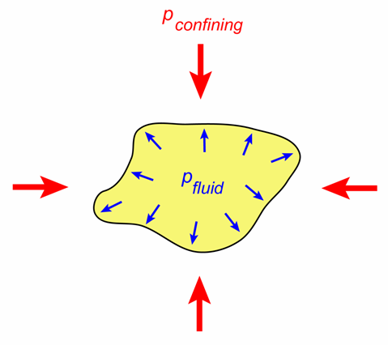
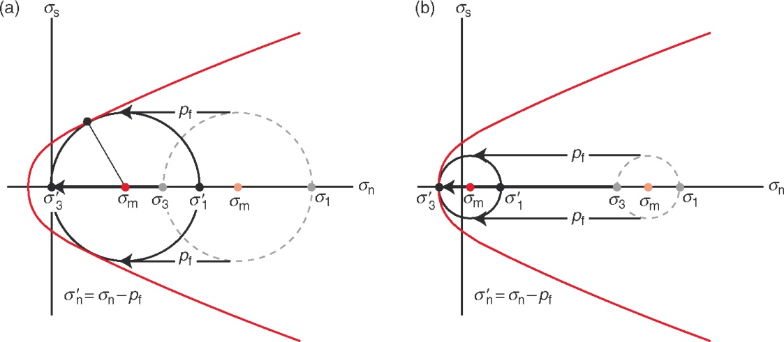

The effect of pore fluids
Extension fractures open → they should be restricted to shallow depths (small confining pressures). But dykes and veins are found to great depths (into the mantle), and the reason why this is possible relates to pore fluid pressure
Pore fluid pressure acts against the normal stresses, while leaving the shear stresses unaffected → on a Mohr diagram pore fluid pressures shift the Mohr circle left without changing its diameter (if the diagram is plotted with σ_{n, eff} not σ_{n} on the x-axis)
Increasing pore fluid pressure leads to a shear fracture if the failure envelope is touched while the effective σ₃ (= σ₃ - p_{fluid}) is still compressive (figure left) or to a hybrid or extension fracture if it is touched when the effective σ₃ is negative (figure right)
Notes:
Fluid pressure acts outwards in a direction everywhere normal to the pore surface. Hence it affects only the normal stresses
Triggering of earthquakes under man-made lakes is a well-documented phenomena that is described using the principles outlined on this slide – water from the lake percolates down through fractures in the subsurface below, raising pore fluid pressures, which then ultimately leads to the earthquake. For a review see Gupta, 2002, Earth Science Reviews 58: 279-310, https://doi.org/10.1016/S0012-8252(02)00063-6. For an analysis of the earthquakes triggered in Egypt following construction of the Aswan Dam, see Adams, 1983, Nature 301: 14, https://doi.org/10.1038/301014a0; and Gahalaut & Hassoup, 2012, Journal of Geophysical Research 117(B2), article B02303, https://doi.org/10.1029/2011JB008796
Figure left (by Steve Covey-Crump) showing the stresses acting on a fluid-filled pore
Figure right from Fossen, p.142

Slide 17
Increasing the significance of fluid pressure
Processes that increase pore fluid pressure relative to the confining pressure and may thereby lead to fracturing include:
  Compaction and cementation: reduces pore volume and so raises pore pressure
  Erosion: removes overburden (decreases confining pressure) and so, if the fluid cannot leak away, this increases the relative significance of the pore pressure
  Osmosis: separation of aqueous fluid reservoirs of different salinities by a semi-permeable membrane (e.g., clay-rich layer) causes fluid diffusion from the less saline fluid to the more saline fluid
  Production of fluid through diagenetic or metamorphic reactions (dehydration of hydrous minerals, e.g., clays, micas, amphiboles, and melting reactions)
  Differences in thermal expansion between the pore fluids and host rocks during heating
An important first step in interpreting natural fractures is to consider the potential significance of each of these

Slide 18
Characterization of fractures
(things to be aware of in the field)

Slide 19
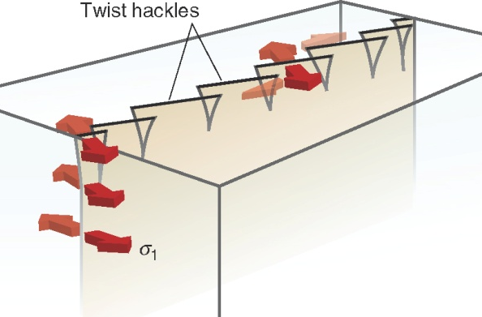
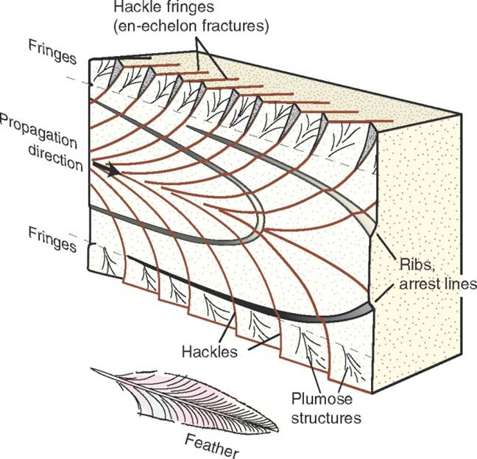
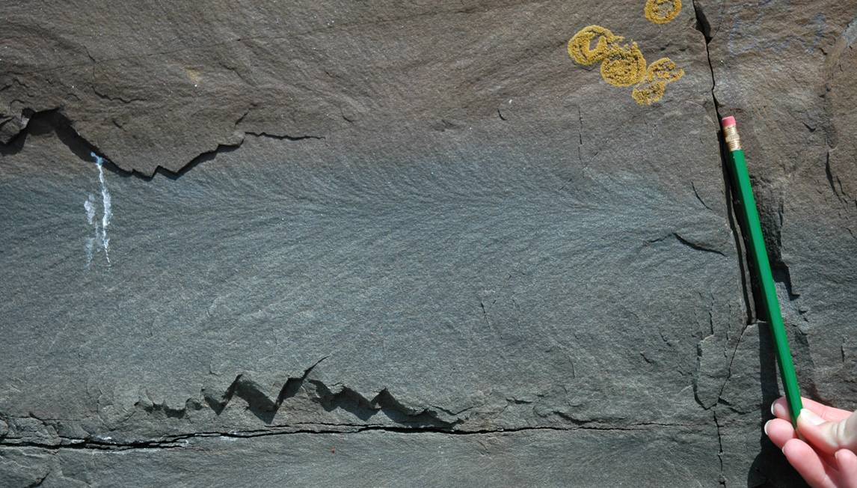
Surface morphology (extension fractures)
The surfaces of extension fractures commonly show a subtle pattern of ridges and grooves (hackle) diverging from a central axis (plumose structures or hackle plumes). These indicate the fracture propagation direction
At the edge of the fracture face, the plane may segment into a series of planes slightly twisted from the main face to form a hackle fringe of en échelon extension fractures. Second order hackle plumes may be developed on the fringe faces
Notes:
Ideally an extension fracture expands radially from some nucleation point in such a way that at any instant during propagation the propagation front has the shape of an ellipse. The rate of propagation increases as the fracture grows and so the fracture surface becomes rougher. Eventually propagation is so fast that stress oscillations or readjustments at the crack tip in response to meeting some interface (e.g., a bedding plane) cause the fracture to bend / twist to form the hackle fringes
Figure bottom left from the 1st edition of Fossen’s book, p.136. For a slightly modified version of the figure, see Fossen, p.165
Figure top right from Fossen, p.166
Photo bottom right (Steve Covey-Crump): plumose structure with hackle fringes (bottom) on a joint face in sandstones at Telpyn Point, Amroth, Pembrokeshire. The direction of propagation of the fracture is right to left

Slide 20
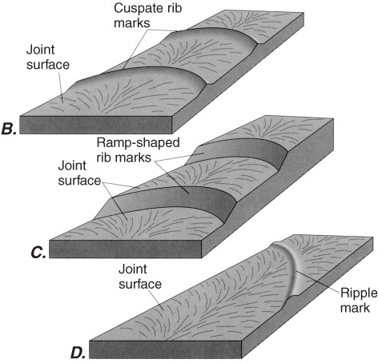
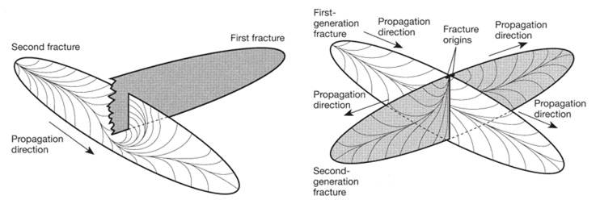
Surface morphology (extension fractures) 2
Sometimes curvilinear rib marks and ripple marks cross the lines of the hackle
Rib marks are cuspate in section or are composed of smoothly curved ramps and are perpendicular to the hackle lines. They are interpreted as arrest lines formed when fracture propagation temporarily stopped
Ripple marks are rounded and oblique to the hackle lines and are thought to form during very fast fracture propagation
Hackle marks on intersecting fracture surfaces may allow the relative timing of fracture formation to be established
Notes:
If you see a ripple mark on a fracture face, be careful to record in your notebook that this is not the sedimentary kind of ripple. Ripple marks on fracture surfaces are also known as Walner lines
For an example of the analysis of fracture development using hackle marks, see Savalli & Engelder, 2005, Geological Society of America Bulletin 117: 436-449, https://doi.org/10.1130/B25368.1
Figure top right from Twiss & Moores, p.53
Figure bottom left from Twiss & Moores, p.56

Slide 21
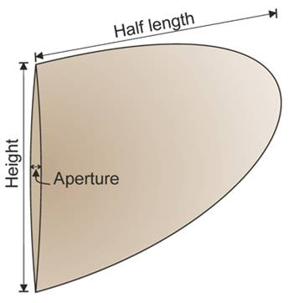
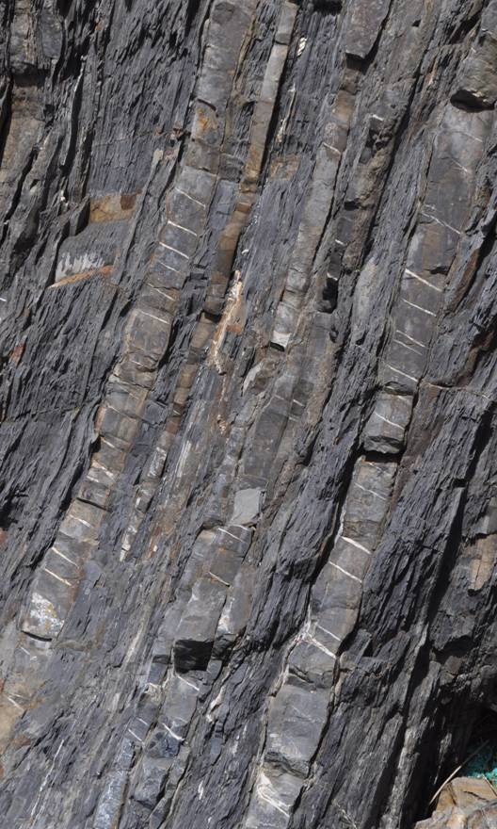
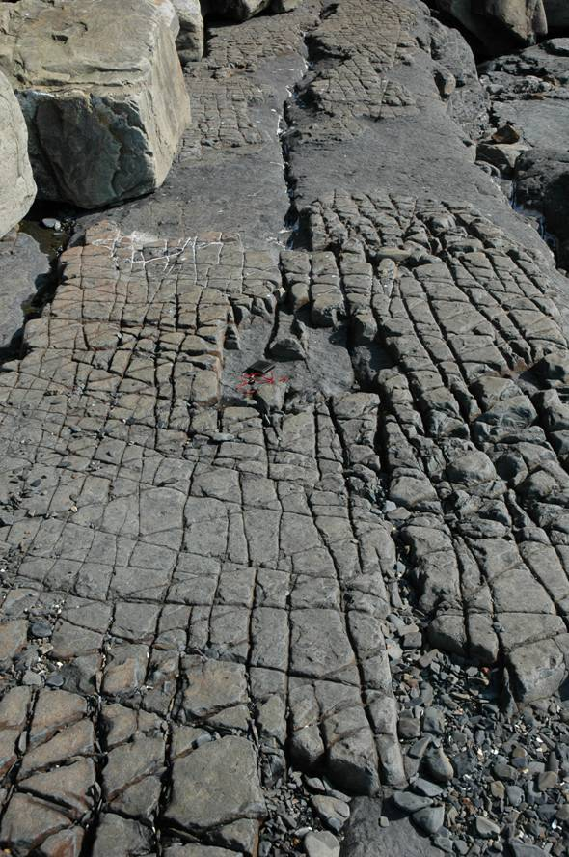
Fracture shape and propagation (extension fractures)
Fractures are generally approximated as elliptical, and this is supported by systematic analyses of hackle and rib marks
Extension fractures propagate in their own plane
Extension fractures that are 10s cm to 100s m long and have repeat distances of several cm to 10s m are known as master joints
In interbedded successions, fracture dimension normal to the layering may be limited by bed thickness
Notes:
Figure top right (from Philipp et al., 2013, Frontiers in Earth Science 1, article 4, https://doi.org/10.3389/feart.2013.00004) showing the terms used to define the dimensions of a fracture
Photo left (Steve Covey-Crump): extension fractures mostly confined to limestone units in an interbedded limestone/mudstone succession, Skrinkle Haven, near Manorbier, Pembrokeshire
Photo middle (Steve Covey-Crump): joints in sandstone interbeds at Telpyn Point, Amroth, Pembrokeshire. Note that the fractures do not extend into the mudstones

Slide 22
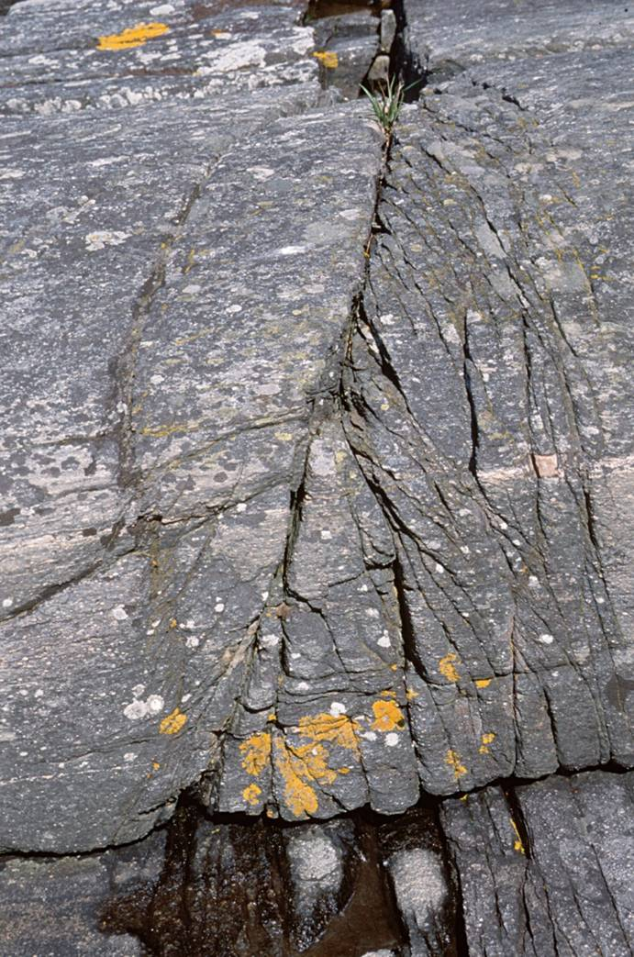
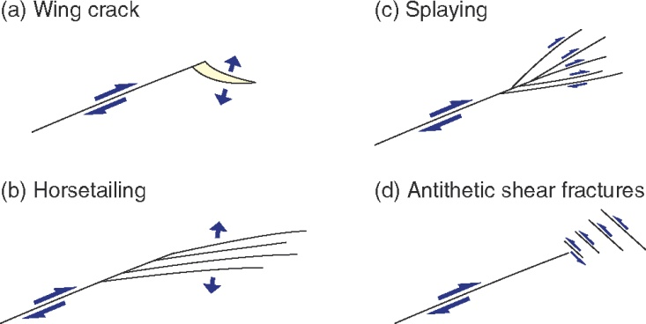
Fracture propagation (shear fractures)
In contrast, shear fractures cannot propagate in their own plane but instead propagate either by generating new extension cracks at their tips (wing cracks) or by linking up already existing extension cracks
At the terminations of shear fractures the displacement of the main fracture is distributed on many smaller fractures, arranged as synthetic shear fractures (splaying), as extension fractures on one side of the fracture (horsetailing), or as antithetic shear fractures
Horsetailing at the end of a shear fracture in gneiss
Notes:
The formation of wing cracks reflects the distribution of stresses around an elliptical hole (the crack) – see Twiss & Moores, p.226-230. We shall come back to this next week when we consider how shear fractures coalesce via wing cracks to form a through-going fault
Note that faults commonly end in sets of splay, horsetail or antithetic shear fractures
Figure from Fossen, p.139
Photo from Fossen, p.139

Slide 23
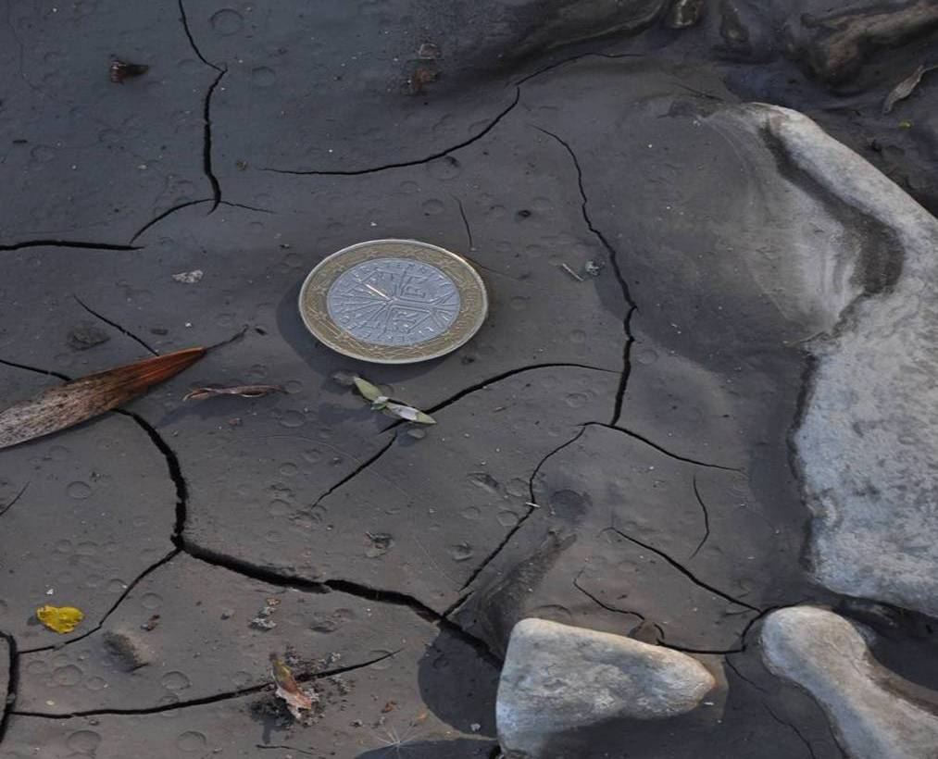
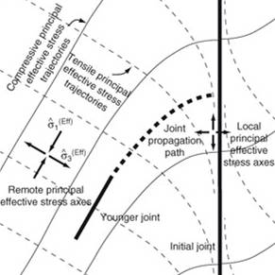
Fracture interaction
The stress field is perturbed around fractures. If a new fracture grows towards another, it encounters the local perturbation of the remote stress field that has been set up by the other fracture and curves so as to maintain a 90° angle to the local σ₃
The sense and extent of curvature depends upon the relative magnitude and orientation of the remote principal stresses and hence provides information about these stresses
Notes:
On the use of joint curvature to estimate palaeostresses, see Dyer, 1988, Journal of Structural Geology 10:685-699, https://doi.org/10.1016/0191-8141(88)90076-4; and Olson & Pollard, 1989, Geology 17: 345-348, https://doi.org/10.1130/0091-7613(1989)017<0345:IPFNFP>2.3.CO;2
Figure left (from Twiss & Moores, p.250) is an example of the interactions between a propagating fracture as it encounters an open old fracture (one that cannot sustain a shear stress). The remote stress field is such that within the locally perturbed stress field a tensile stress acts along the old fracture. In this case the new fracture intersects the old one at 90°. If a compressive stress acted along the old fracture the intersection would be at 0°. If the old fracture is closed and can support a shear stress, any angle between 0° and 90° is conceivable depending upon the remote stresses. For further discussion, see Twiss & Moores, p.248-250
Photo right (Steve Covey-Crump): mudcracks in the riverbed of L’Asse de Clumanc, Barrême, France. Note how the crack just to the right of the coin curves as it approaches the earlier crack

Slide 24
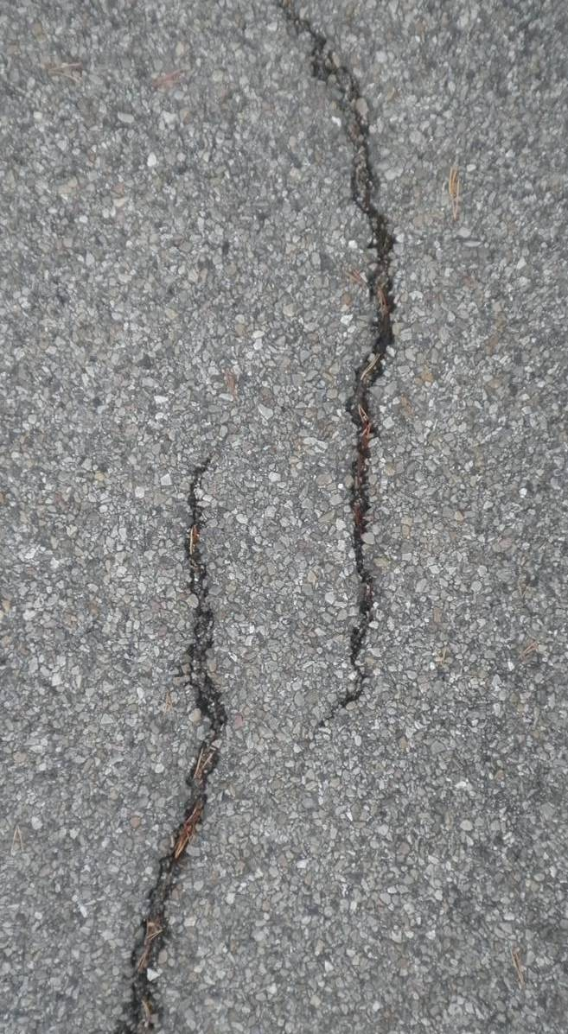
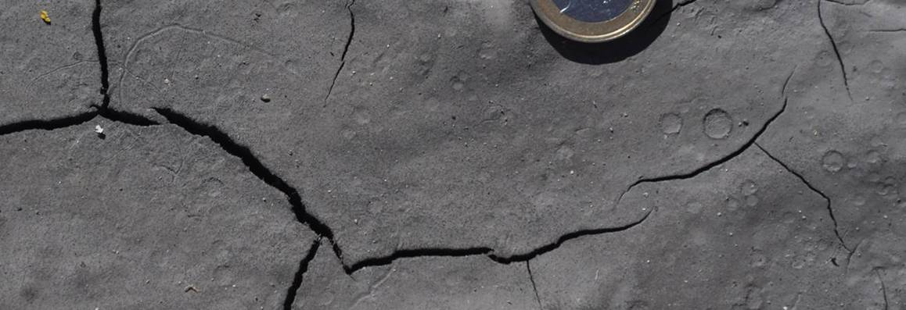
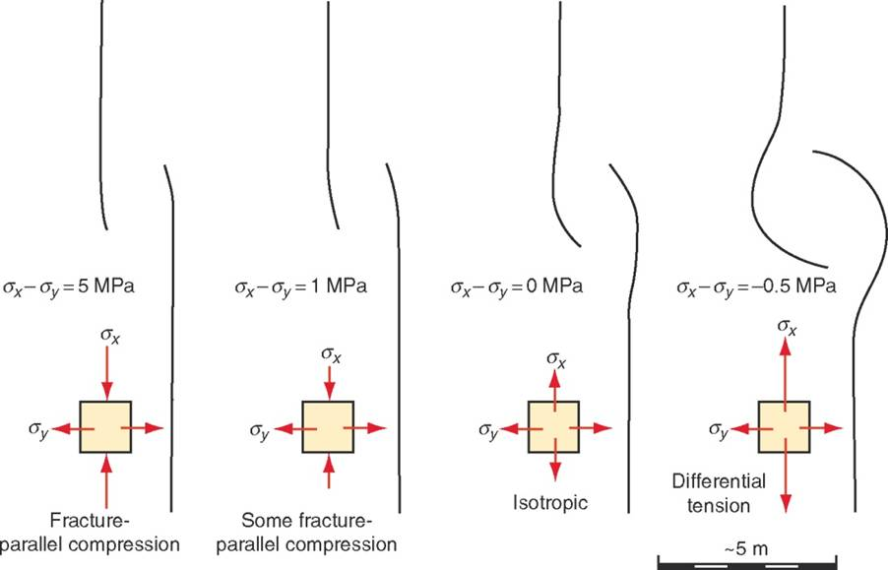
Interaction of parallel fractures
Notes:
Photo left (Steve Covey-Crump): fractures in the road at Senez, Barrême, France. This is an example of the case drawn second from the left in the figure shown on this slide, in which σ_{x} - σ_{y} > 0 (σ_{x} is parallel to the fracture). Whether or not the stresses parallel to the fracture are actually compressive as depicted by my red arrows is unclear (σ_{x} might be tensile but less tensile than σ_{y})
Photo top right (Steve Covey-Crump): mudcracks in the riverbed of L’Asse de Clumanc, Barrême, France. Note the curvature of the cracks below right of my red arrows which implies σ_{x} - σ_{y} < 0. In mudcracking the stresses are of course all tensile
Figure bottom right from the 1st edition of Fossen’s book, p.138. For comments on the interaction of parallel fractures in the 2nd edition of his book, see Fossen, p.166-167

Slide 25
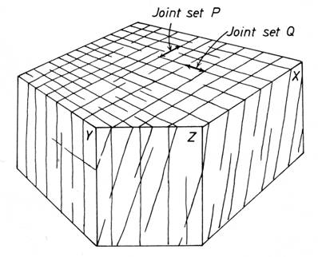
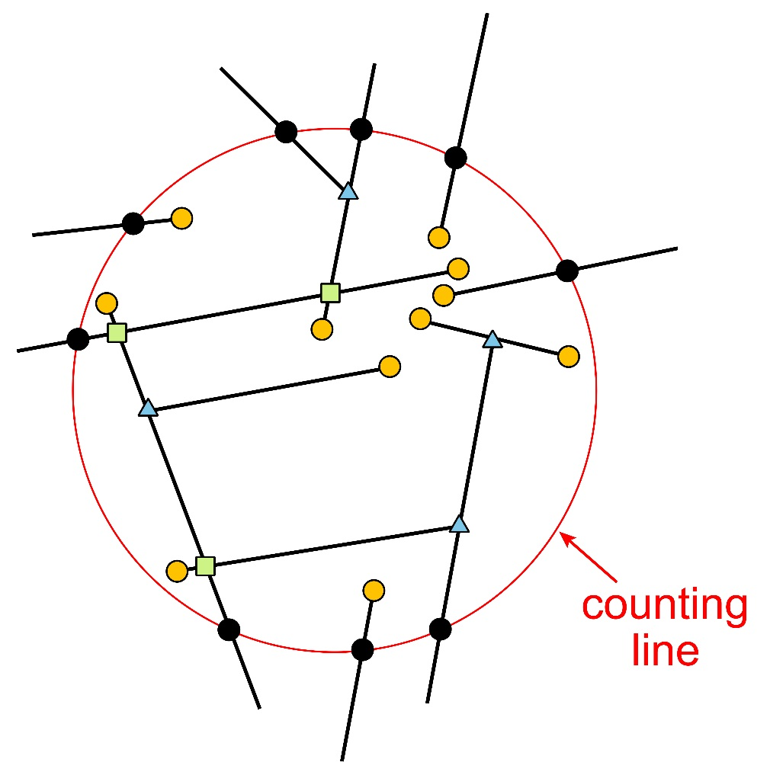
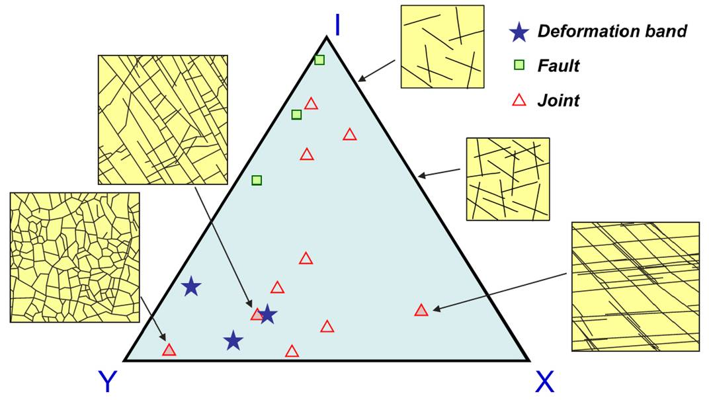
Measurements of fracture density
Estimating fracture spacing and intensity is important for engineering and fluid flow applications
Estimates are obtained by counting the number of fractures intersecting a line (preferably circular to avoid ‘cut effects’ arising from the orientation of the sampling plane)
If combined with counts of fracture tips and fracture intersections, we can characterize the topology of fracture network and assess fracture connectivity
Different impressions of joint frequency on different planes
Notes:
For fracture traces = intersection of a fracture on a plane of measurement, we may define fracture trace intensity = mean total length of fractures per unit area; fracture trace density = mean number of fracture centres per unit area; mean fracture trace length = mean fracture length for the individual fractures of a fracture population. Note that correlating the statistics of fracture traces measured in 2d with those of their parent 3d fracture network is a further step in the analysis (e.g., see Zhang et al., 2002, Géotechnique 52: 419-433, https://doi.org/10.1680/geot.2002.52.6.419)
Some important practical papers
A description of practical strategies for evaluating these fracture trace parameters is given by Rohrbaugh et al., 2002, American Association of Petroleum Geologists Bulletin 86: 2089-2104, https://doi.org/10.1306/61EEDE0E-173E-11D7-8645000102C1865D
For an updated commentary on these strategies, see Watkins et al., 2015, Journal of Structural Geology 72: 67-82, https://doi.org/10.1016/j.jsg.2015.02.001; and Sanderson & Peacock, 2019, Journal of Structural Geology 122: 27-37, https://doi.org/10.1016/j.jsg.2019.02.006, with comments on the uncertainties arising in different methods of measuring fracture density given by Zeeb et al., 2013, American Association of Petroleum Geologists Bulletin 97: 1545-1566, https://doi.org/10.1306/02131312042
For an account of how these approaches may be combined with counts of fracture tips and fracture intersections to define the topology of the fracture network, see Sanderson & Nixon, 2015, Journal of Structural Geology 72: 55-66, https://doi.org/10.1016/j.jsg.2015.01.005; and Sanderson et al., 2019, Journal of Structural Geology 125: 155-165, https://doi.org/10.1016/j.jsg.2018.04.011.
Examples of how topological parameters may be used include (1) Duffy et al., 2017, Journal of Structural Geology 96: 192-202, https://doi.org/10.1016/j.jsg.2017.02.001; (2) Procter & Sanderson, 2018, Journal of Structural Geology 108: 52-65, https://doi.org/10.1016/j.jsg.2017.07.008; (3) Sanderson & Nixon, 2018, Journal of Structural Geology 115: 167-177, https://doi.org/10.1016/j.jsg.2018.07.011; (4) Grodner et al., 2021, Journal of Structural Geology 153, article 104468, https://doi.org/10.1016/j.jsg.2021.104468; (5) Forstner & Laubach, 2022, Journal of Structural Geology 165: article 104748, https://doi.org/10.1016/j.jsg.2022.104748; (6) Ovaskainen et al., 2022, Journal of Structural Geology 155, article 104528, https://doi.org/10.1016/j.jsg.2022.104528
It quickly becomes apparent when one attempts to measure fracture parameters that deciding what is or is not a fracture in an image or indeed in real life, can have a heavy element of subjectivity. For assessment of the significance of this, see Peacock et al., 2019, Norwegian Journal of Geology 99: 113-128, https://dx.doi.org/10.17850/njg99-1-06; and Andrews et al., 2019, Solid Earth 10: 487-516, https://doi.org/10.5194/se-10-487-2019
Twiss & Moores (p.46-52) describe a simple strategy for assessing if the spacing of fractures is fractal, that is, for establishing if there is a power law relationship between fracture frequency and fracture size
For a systematic classification of fracture networks based on fracture type (extension, contraction, shear, hybrid – see Slide 7) and fracture network topology, which also pays attention to the relative age relationships of the fractures in the network and whether or not they are kinematically related (formed in the same displacement field), see Peacock et al., 2018, Journal of Structural Geology 106: 41-53, https://doi.org/10.1016/j.jsg.2017.11.010
Figure top right (from Ramsay & Huber, p.648) highlighting the fact that we get a different impression of fracture frequency and the number of differently oriented fracture sets on differently oriented planes. Using a circular count line minimizes these issues provided the plane on which the counting is performed is not parallel to one of the fracture sets
Figure bottom left (by Steve Covey-Crump): counting fractures using a circular count line (in red); the counted intersections are the black circles. An estimate of fracture trace intensity is then given by n/(4r) when n is the number of intersections and r is the radius of the circle. By counting fracture tips within the counting circle (orange circles) then an estimate of fracture trace density is given by m/(2πr²) where m is the number of tips. An estimate of mean trace length is given by (n/m)πr/2. For derivations of these expressions, see Mauldon et al., 2001, Journal of Structural Geology 23: 247-258, https://doi.org/10.1016/S0191-8141(00)00094-8. Reliable estimates of mean trace length require m > 30. This can be achieved by combining the results from several circles in different locations at the sample site. To make these measurements in the field, take a metre long piece of string or rope and some chalk into the field. For an example of the practicalities, see Procter & Sanderson, 2018, Journal of Structural Geology 108: 52-65, https://doi.org/10.1016/j.jsg.2017.07.008
Figure bottom right (modified by Steve Covey-Crump from Sanderson & Nixon, 2015, Journal of Structural Geology 72: 55-66, https://doi.org/10.1016/j.jsg.2015.01.005): showing the different fracture network topologies obtained by comparing counts of fracture tips (orange circles in the figure to the left = node type I), fracture intersections where one fracture terminates against another (blue triangles in the figure to the left = node type Y), and fracture intersections where one fracture crosses another (green squares in the figure to the left = node type X). The triangular plot shows the proportions of node types for several different fracture networks

Slide 26
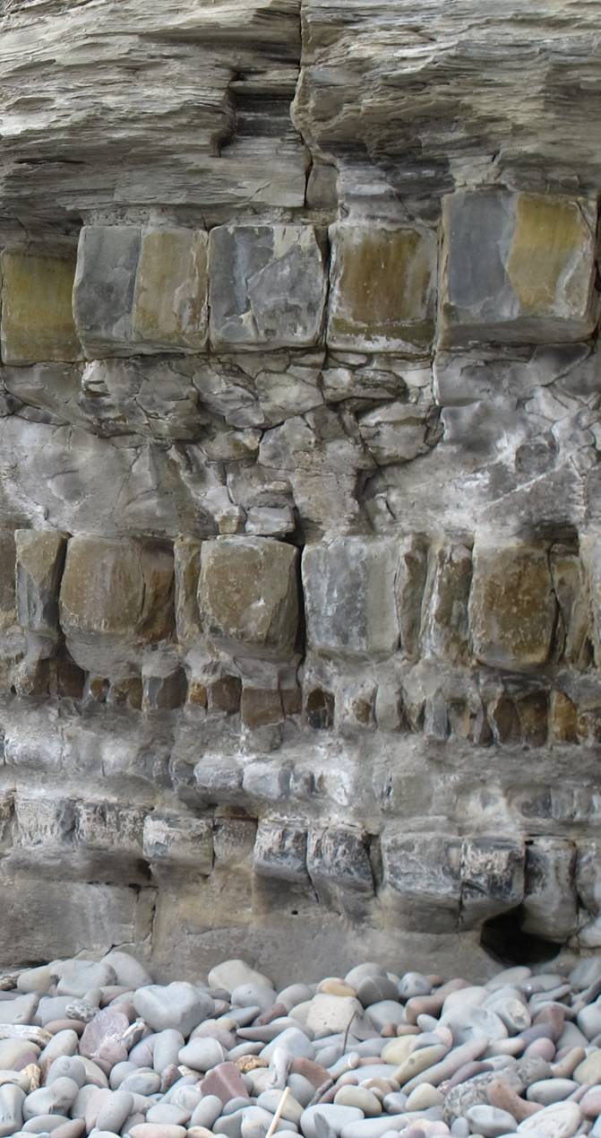
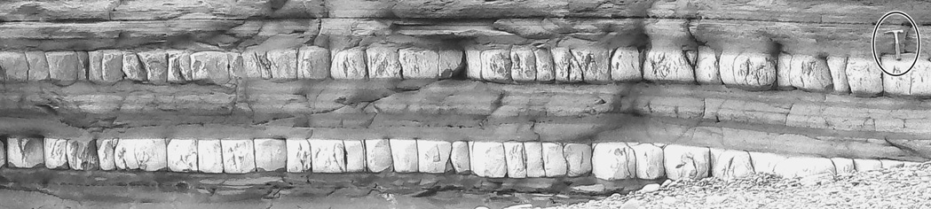


Spacing of fractures 2
Fracture spacing changes with bed thickness and bed rigidity, and is influenced by the nature of the interfaces between beds → changes during diagenesis
Notes:
Examples of fracture spacing studies include: Ladeira & Price, 1981, Journal of Structural Geology 3: 179-183, https://doi.org/10.1016/0191-8141(81)90013-4; and Narr & Suppe, 1991, Journal of Structural Geology 13: 1037-1048, https://doi.org/10.1016/0191-8141(91)90055-N
A study of the effect of changing bed rigidity on joint spacing that was carried out at Oliana (NE Spain) is Shackleton et al., 2005, Geology 33: 101-104, https://doi.org/10.1130/G20930.1
Theoretical studies of the controls on joint spacing (e.g., Jain et al., 2007, Journal of Structural Geology 29: 288-297, https://doi.org/10.1016/j.jsg.2006.08.010; Schöpfer et al., 2011, Journal of Structural Geology 33: 551-565, https://doi.org/10.1016/j.jsg.2011.01.008; and references therein) are beyond the level of this course but see some introductory remarks in Twiss & Moores, p.250-251
For comments on the statistics of fracture spacings, see Hobbs et al., 2022, Journal of Structural Geology 156, article 104529, https://doi.org/10.1016/j.jsg.2022.104529
Photo left (from https://commons.wikimedia.org/wiki/File:Joint_spacing_varying_with_bed_thickness.jpg): variation of joint spacing with bed thickness, Jurassic units, Lilstock Bay, Somerset. Note that the thick beds have more widely spaced joints
Photo top right (from Schöpfer et al., 2011, Journal of Structural Geology 33: 551-565, https://doi.org/10.1016/j.jsg.2011.01.008): joint spacing approximately equal to bed thickness, Lilstock Bay, Somerset
Figure middle (from Fossen, p.162): relationship between joint spacing and bed thickness from three studies
Figure bottom right (from J-P Burg’s 2016 lecture notes, www.files.ethz.ch/structuralgeology/JPB/files/English/4joints.pdf, p.132): relationship between joint spacing and bed rigidity

Slide 27


Fracture orientation
A fracture set is a group of fractures of similar orientation (strike/dip)
The orientations of near vertical fractures are conveniently presented in a rose diagram; fractures that are not vertical are best presented on a stereogram
The orientation of genetically-related fractures may change from one lithology to another, and so it may be convenient to separate the joints by lithology before plotting or to plot a split rose diagram
Notes:
Photo (Steve Covey-Crump): fracture ‘refraction’ within metamorphosed sandstones, Moine metasedimentary units, Ross of Mull, Scotland
Figure (from Twiss & Moores, p.43, but deriving from Nichelsen & Hough, 1967, Geological Society of America Bulletin 78: 609-630, https://doi.org/10.1130/0016-7606(1967)78[609:JITAPO]2.0.CO;2): rose diagram of joint data from the Houtzdale quadrangle on the Appalachian Plateau. Note the difference in orientation of the joints in the two lithologies

Slide 28

Fractures in slightly deformed sedimentary rocks
One of the features of horizontally bedded sedimentary successions that have been subjected to little or no deformation is the presence of well-defined, near vertical fracture sets
These result from changes in horizontal stresses during erosion and uplift
We saw in the last class that in the absence of tectonic stresses Poisson effects and changes in temperature during burial and subsequent erosion / uplift lead to a stress state in which the maximum compressive stress (σ₁) is vertical and the least compressive stress (σ₃) is horizontal
If there is sufficient pore fluid pressure to make the effective σ₃ tensile then a vertical fracture set forms normal to σ₃
This relieves the stress in that direction, and so if the other horizontal principal effective stress is also tensile, that becomes the maximum effective tensile stress, and a second set of vertical joints forms orthogonal to the first
Notes:
The relevant bit of the last class was the discussion of the uniaxial strain reference state for horizontal stresses in the lithosphere (Class 5 Slide 29). In the uniaxial reference state, the horizontal stresses are about 0.33 to 0.5 times the vertical stress
Photo (from Fossen, p.91): joints in the Permian sandstones of the Colorado Plateau, exposed in the Colorado River

Slide 29

Fractures in slightly deformed sedimentary rocks
One may adapt simple models of this kind to include stresses set up by lithospheric flexure during burial and uplift, or to include far-field stresses
E.g., analysis of the stresses in a rectangular slab subjected to horizontal compression, allows the stresses within a foreland sedimentary succession to be predicted: σ₁ ~ horizontal and so since σ₂ ~ σ₃ one can make a case for σ₃ being horizontal. Hence fractures should be vertical
Near to the thrust front, where σ₁ is large, these will be conjugate vertical shear fractures, but as σ₁ decreases away from the thrust front, vertical extension fractures are expected
Such models help to explain why non-orthogonal vertical fracture sets are present in lightly deformed sedimentary successions
Notes:
The model predicting the stresses within a rectangular block subjected to horizontal compressive loading was first presented by Hafner, 1951, Geological Society of America Bulletin 62: 373-398, https://doi.org/10.1130/0016-7606(1951)62[373:SDAF]2.0.CO;2 (see also Twiss and Moores’ worked problem, p.201-208, although that does not consider the stresses within the block). The interpretation of the orientation of the fractures that Hafner’s model implies in foreland sediments is described in Price & Cosgrove, p.212-213; their Chapter 9 contains much else that is of interest for interpreting regional vertical fracture sets
Figure from Price & Cosgrove, p.213

Slide 30

Fractures associated with faults
Apart from tension gashes and pinnate fractures, around faults there is frequently a closely spaced set of fault-parallel fractures, and a more weakly developed set of shear fractures in the conjugate orientation at about 60° to the fault
For dip-slip faults these are conveniently visualized on a rose diagram constructed in the plane containing the slip vector and the pole to the fault plane
Notes:
This rose diagram shows the virtue in being imaginative in selecting the plane for the diagram – it does not have to be the horizontal plane
Figure from Twiss & Moores, p.57

Slide 31

Fractures associated with folds
Fractures develop in a variety of orientations in association with folds:
  Longitudinal (bc) joints: parallel to the fold axis and orthogonal to bedding
  Cross (ac) joints: parallel to the profile plane
  Two conjugate sets of oblique joints: one conjugate pair bisected by bc joints (found in fold hinges) and the other bisected by ac joints (found in fold limbs)
Other fracture sets may be found in the inner and outer arcs of fold hinges (stereograms C and E below)
Considerable uncertainty exists over how these fracture sets form and when they form relative to the growth of the fold
Notes:
For an example of an analysis of fractures around a fold which concludes that they probably formed before buckling, see Silliphant et al., 2002, Journal of Structural Geology 24: 155-172, https://doi.org/10.1016/S0191-8141(01)00055-4. For an example based on the Teton anticline in Montana, U.S.A., a structure that has several times been used to consider fold-fracture interrelationships, see Burberry et al., 2020, Geological Society, London, Special Publications 487: 229-261, https://doi.org/10.1144/SP487.12
The important point to take home from this class is that when mapping do not ignore minor fractures. They have an important influence on rock properties even if their formation is not yet fully understood
Figure from Twiss & Moores, p.58

Slide 32


Exfoliation (sheet) joints
Exfoliation joints are extension fractures that are smoothly curved over 100s metres and sub-parallel to topography. They are best seen in plutonic rocks
In a magma at depth the stresses are ~ lithostatic
σ₁ = σ₂ = σ₃ = ρ g h
After unroofing to the surface then in the pluton
Δσ_{v} = - ρ g Δh ; Δσ_{h} = [ν / (1- ν ) ] ρ g Δh
σ_{v} = σ₃ = 0 ; σ_{h} = σ₁ = [ (1-2ν ) / (1- ν ) ] ρ g Δh
assuming no lateral expansion / contraction. For
Δh = 5 km, ν = 0.25, ρ = 3 gcm⁻³ then σ_{h} = 100 MPa
→ there is a large horizontal compressive stress available to cause surface-parallel fracturing
Notes:
For a review of exfoliation joints, see Martel, 2017, Journal of Structural Geology 94: 68-86, https://doi.org/10.1016/j.jsg.2016.11.003. Exfoliation joints occur in a wide range of lithologies, not just large igneous intrusions
The stresses in a magma at depth are inferred to be lithostatic if we take the magma to be a fluid with no shear strength. The usual meaning of the symbols apply: ρ is density, g is the acceleration due to gravity, h is depth, σ_{v} is vertical stress, σ_{h} is horizontal stress, and ν is Poisson’s ratio. The expression, Δσ_{h} = [ν/(1-ν)] ρgΔh, is the change in horizontal stress assuming that the rock cannot expand sideways (see Class 5 Slide 29). Hence
σ_{h} = σ_{h , initial} - Δσ_{h} = ρgh - [ν / (1-ν)] ρgΔh = [(1-2ν)/(1-ν)] ρgΔh for h = Δh
This analysis is carried out in slightly more detail by Turcotte & Schubert, 2002, Geodynamics (2nd edition), p.109. Note that it ignores temperature changes during exhumation. Other mechanisms for exfoliation joint formation have been proposed (Twiss & Moores, p.246; Price & Cosgrove, p.105-110; Martel, 2017, Journal of Structural Geology 94: 68-86, https://doi.org/10.1016/j.jsg.2016.11.003)
Photo top (Steve Covey-Crump): exfoliation joints on the Bodmin Moor granite
Photo bottom (from www.appstate.edu/~marshallst/photos/boone_photos/half_dome_3.html): exfoliation joints in a granite pluton, Half Dome, Yosemite National Park, California

Slide 33
Veins and hypabyssal intrusions

Slide 34


Joint infill, veins and hydraulic fracturing
Fracture surfaces may contain a thin mineral deposit (e.g., quartz, feldspar, calcite, zeolites) that indicates the importance of fluids during their formation (assuming that the fluids did not come in later and use the fractures as conduits)
Veins form when fluid pressure builds up sufficiently to generate extension fractures (hydraulic fracturing), and minerals are then precipitated out of solution – in most cases solubility decreases with decreasing fluid pressure (that is, as a fracture opens)
In areas of very high fluid pressure tectonic brecciation may occur during hydraulic fracturing
Notes:
Since veins and joints are both extension fractures, it is tempting to treat them in the same way. However, they form at different times and under different conditions. For some cautionary notes on this matter, see Peacock, 2004, Geological Society, London, Special Publications 231: 209-221, https://doi.org/10.1144/GSL.SP.2004.231.01.12
Veins allow the possibility of measuring fracture aperture, that is, how much they have opened. For methods of carrying out such an analysis, see Hooker et al., 2014, Geological Society of America Bulletin 126: 1340-1362, https://doi.org/10.1130/B30945.1
Those going on the Easter field course to Scotland will see an example of brecciation induced by high fluid pressures in the country rock at the margins of the Kentallen pluton
In metamorphic complexes, quartz generated in metamorphic reactions is dissolved in pore fluids at depth and is then precipitated in veins as those fluids migrate upwards and cool/depressurize
Photo top (from Ramsay & Huber, p.644): bleached joints in granitic gneiss, Lavertezzo, Switzerland
Photo bottom (Fossen, one of the extra figures on the web-site for the book, folk.uib.no/nglhe/StructuralGeoBook.html): brecciation in a sinistral shear fracture, Oslo

Slide 35

Emplacement of intrusions
Intrusion of magma as planar sheets requires the magma to flow into a pre-existing open fissure or to be forcefully injected. Since open fissures cannot exist at depth, the emplacement of such sheets must usually include at least a component of forceful injection, that is, of hydraulic fracturing
Notes:
Photo (from the BGS image database: geoscenic.bgs.ac.uk/asset-bank/action/viewHome, image P215114): base of a dolerite sill forcefully intruding Lower Carboniferous sandstones, Hound Point, South Queensferry, near Edinburgh

Slide 36



Parallel-sided intrusions
Here we focus on the emplacement of sub-vertical sheets and sub-horizontal sheets (dykes and sills)
Bedding is vertical in both these cases and so the ‘sill’ (left) is discordant, and the ‘dyke’ (right) is concordant
not considered
Notes:
There is not enough time to consider the formation of systematically oriented minor intrusions around larger scale igneous bodies. The orientation of these depends upon the particular environment in which intrusion occurs. For remarks on this topic, see Price & Cosgrove p.102-105 (general remarks), Price & Cosgrove p.73-76 (radiating dykes), and Magee et al., 2012, Journal of Structural Geology 43: 73-91, https://doi.org/10.1016/j.jsg.2012.08.004 (inclined sheets/cone sheets)
Photo left (Steve Covey-Crump): flat-lying Tertiary sheets, Ross of Mull, Scotland
Photo right (Steve Covey-Crump): near vertical Permo-Carboniferous intrusion, Ross of Mull, Scotland
Figure (from J-P Burg’s 2016 lecture notes, www.files.ethz.ch/structuralgeology/JPB/files/English/4joints.pdf, p.151): some significant fracture types around a central intrusion with a caldera

Slide 37

Buoyancy
The force driving hydraulic fracturing during emplacement of intrusions comes from the buoyancy force of the magma
Buoyancy = magma pressure minus vertical stress in the surrounding rock, and so it arises from the lower density of the magma compared with its host rock
A
Derivation of the buoyancy equation. Note that it is assumed that the pressure in the magma chamber is lithostatic
Notes:
Figure by Steve Covey-Crump based on Price & Cosgrove, p.61. p_{magma} is the magma pressure which in the magma chamber is here given by the weight of the overlying column of rock

Slide 38


Formation of dykes
The intrusion of a vertical dyke requires that
p_{magma} - σ_{h} > T_{h}
where T_{h} is the tensile strength of the rock in the horizontal direction
With some simplifying assumptions one can show the magma overpressure (p_{magma} - σ_{h}) is given by
A
W
where E and ν are Young’s modulus and Poisson’s ratio for the crust, and A and W are the dyke aperture and width. Dyke injection will occur when p_{over} = T_{h}
Field measurement of dyke dimensions from the Vogar swarm, Reykjanes Peninsula, Iceland, and realistic values of E and ν , gives p_{over} = 4 MPa. This very small value for the horizontal tensile strength of the rock perhaps reflects its already fractured state
With such small magma overpressures required, minor changes in horizontal rock strength can have a profound effect on the extent and orientation of dykes
Notes:
The equation for magma overpressure is Eq. 9.15 of Gudmundsson (who also derives it). For his original development of this equation, see Gudmundsson, 1983, Journal of Structural Geology 5: 623-626, https://doi.org/10.1016/0191-8141(83)90075-5
If you could estimate the along strike length (W) of a mapped dyke, then combined with a measurement of its thickness (A), you could evaluate the magma overpressure and hence the horizontal tensile strength of your country rocks (values of E and ν are easily obtained from the literature). When along strike length is not easily obtained, a value of W/A = 1500, based on dyke measurements worldwide, has been used, e.g., Browning et al., 2015, Nature, Scientific Reports 5, article 15785, https://doi.org/10.1038/srep15785. Descriptions of fracture aperture (effectively A) are given by Hooker et al., 2014, Geological Society of America Bulletin 126: 1340-1362, https://doi.org/10.1130/B30945.1
For a more detailed analysis which allows the orientation and magnitudes of the principal stresses to be obtained from dyke orientation and dimension data, see Lahiri et al., 2019, Journal of Structural Geology 124: 23-34, https://doi.org/10.1016/j.jsg.2019.04.001. This utilizes Mohr circle techniques presented by Jolly & Sanderson, 1997, Journal of Structural Geology 19: 887-892, https://doi.org/10.1016/S0191-8141(97)00014-X
Figure from Gudmundsson, p.271

Slide 39

Formation of sills
Intrusion of a horizontal sill (sheet) requires
p_{magma} - σ_{v} > T_{v}
where T_{v} is the tensile strength of the rock in the vertical direction
Sills must be fed by a feeder ‘dyke’, and so at the junction of sill and dyke (see figure right)
σ_{v} - σ_{h} = T_{h} - T_{v}
Since both T_{v} and T_{h} are small (the tensile strength of rocks is small), this means that the condition for the intrusion of a sill is that σ_{v} - σ_{h} ~ 0
Magma will rise as a dyke while σ_{v} > σ_{h} but σ_{v} decreases towards the surface, and so there eventually comes a point where σ_{v} - σ_{h} ~ 0 and a sill becomes possible; a sill is then favoured if T_{h} - T_{v} > 0 (as it commonly is in horizontally layered successions)
Notes:
For a review of the mechanics of dyke and sill emplacement, see Rivalta, 2015, Tectonophysics 638: 1-42, https://doi.org/10.1016/j.tecto.2014.10.003. For some experiments examining emplacement of more complexly shaped igneous bodies, see Bertelsen et al., 2018, Frontiers in Earth Science 6, article 199, https://doi.org/10.3389/feart.2018.00199
Figure by Steve Covey-Crump based on Price & Cosgrove, p.77

Slide 40




Deflection and arrest of hydraulic fractures
When a propagating hydraulic fracture meets a layer with local stresses that are unfavourable for continued propagation, it may
  arrest,
  penetrate the contact, or
  deflect along the contact in
  one or two directions
Notes:
A field study of what happens when fractures meet interfaces is presented by Larsen et al., 2010, Marine and Petroleum Geology 27: 1531-1550, https://doi.org/10.1016/j.marpetgeo.2010.03.011
Photo left (Steve Covey-Crump): deflected vein, Carboniferous limestones, West Angle Bay, Pembrokeshire
Photos right (Steve Covey-Crump): arrested hydraulic fractures in sandstone/mudstone interbeds, Marloes Sands, Pembrokeshire. The bottom right photo is an enlargement of part of the top right photo – note how the fractures start to propagate into the mudstones by attempting to open up cleavage surfaces
Figure from Gudmundsson, p.382

Slide 41


Deflection and arrest of hydraulic fractures 2
In part these responses reflect the change in local orientation of the principal stresses in the neighbourhood of a mechanical discontinuity (e.g., bedding surface) but two other factors play a part:
Delamination: the tensile stresses generated normal to the tip of a propagating hydraulic fracture induce tensile stresses parallel to the fracture through the Poisson effect. If the tensile strength is small in this direction (e.g., because of an interface), a crack will open up, and the intrusion will propagate sideways
Cook-Gordon debonding (delamination)
Right-left trending dyke deflected along a mechanical discontinuity and sending off-shoots along it
Notes:
For “change in the local orientation of the principal stresses in the neighbourhood of a mechanical discontinuity”, see Slide 23
By ‘Poisson effect’, I am referring to the observation that stretching in one direction leads to contraction in the direction at right angles to this
Figure redrawn by Steve Covey-Crump from Price & Cosgrove, p.77
Photo (Steve Covey-Crump): Tertiary sub-vertical dyke, Ross of Mull, Scotland

Slide 42


Deflection and arrest of hydraulic fractures 3
Material property mismatch: when a propagating fracture meets an interface with a layer that is elastically stiffer than the one it has been propagating through, it is energetically favourable for the crack to deflect along the interface
This is not true when it meets a layer that is elastically more compliant
Vein propagation clearly influenced by interfaces
Notes:
Gudmundsson provides the analysis that shows this (p.384-388)
Photo left (Steve Covey-Crump): Devonian units at Pembrokeshire
Photo right (Steve Covey-Crump): Carboniferous limestones at West Angle Bay, Pembrokeshire

Slide 43



Fracture-controlled emplacement
Deflection of intrusions along fractures may lead to interpretative challenges: on the map to the right, has the dolerite dyke been offset by a fault in the gully or has it exploited a fracture?
(Above) the dyke above looks sinistrally offset but has probably just exploited a pre-existing fracture. (Right) the dyke is unambiguously interpreted
Notes:
Photo bottom right (Steve Covey-Crump): a dyke within the Onich shore section, Scotland
Photo left (Steve Covey-Crump): a Tertiary dyke, Ross of Mull, Scotland
Figure top right from Price & Cosgrove, p.60

Slide 44


Fracture controlled emplacement 2
The walls of this dyke have clearly been influenced by a pre-existing joint set
The steps in the dyke walls can be matched up across the dyke to indicate that the fracture hosting the dyke was hybrid (sinistral transtension)
Notes:
Photo (from the BGS image database: geoscenic.bgs.ac.uk/asset-bank/action/viewHome, image P215588): a dyke in Glen Coe at the foot of Stob nan Cabar. Those of you going on the Easter field course to Scotland will be making a compass-and-pace map of dykes nearby this one
Figure by Steve Covey-Crump

Slide 45


En échelon dykes
Rotation of the stress field as the fracture propagates towards the surface (in a manner similar to the formation of hackle fringes) may lead to the formation of en échelon dyke arrays. The extent to which this formation mechanism can be distinguished from genuine transtension is not clear
En échelon dyke arrays introduce a world of new jargon (bridge, horn, etc.)
Notes:
For a review of en échelon / segmented dyke arrays and what can be deduced about dyke emplacement from them, see Magee et al., 2019, Journal of Structural Geology 125: 148-154, https://doi.org/10.1016/j.jsg.2018.07.010
We noted hackle fringes on Slide 19
Figures left and right are from Price & Cosgrove, p.77
Figure middle figure is from Fossen, p.166 (see also Fossen, p.230-231). In this model, in which the stress field rotates towards the surface, the angle between individual dykes and the boundaries of the en échelon array is small

Slide 46


En échelon dykes
As the individual fractures in an en échelon array propagate and enter each other’s stress field they curve in the manner described previously for ‘dry’ fractures. The nature of that curvature is sensitive to whether fracture propagation is controlled by the remote stresses or by the magma pressure
Notes:
The interactions between parallel fractures were noted on Slide 24
Figure redrawn by Steve Covey-Crump from Morris et al., 2008, Geological Society of London, Special Publication 302: 149-158, https://doi.org/10.1144/SP302.11
Photo (from Ramsay & Lisle, 2000, The Techniques of Modern Structural Geology, Volume 3: Applications of Continuum Mechanics in Structural Geology, p.770): horn structures on dykes, Itivdleq, West Greenland

Slide 47

En échelon dykes
This en échelon pair of dykes have exploited a cross-joint to join up (note the flow banding in the dyke); fracture propagation was probably controlled by remote stresses
Notes:
Photo (Steve-Covey-Crump): andesitic dyke within the area in Glen Coe that those of you going on the Easter field course to Scotland will map using the compass-and-pace technique. Compare the geometry shown here with that on the left-hand side of the figure on the preceding slide. The implication is that emplacement of this dyke was influenced by far-field (tectonic) stresses rather than by stresses set up by the magma pressure
A protocol for systematically analysing how well linked veins within a vein array are, using measurements of vein length, width and orientation, is described by Sanderson & Peacock, 2019, Journal of Structural Geology 118: 104-113, https://doi.org/10.1016/j.jsg.2018.10.001

Slide 48
Polygonal fractures

Slide 49



Polygonal fracture networks
Contraction due to cooling or to dessication leads to the formation of networks of orthogonal (top left) or polygonal (top right) fractures
Patterned ground on Mars: the larger orthogonal array is interpreted as dessication cracks formed during the drying of a lake; the smaller scale polygonal network as due to cyclic thermal expansion-contraction
Notes:
For a helpful summary of the formation of polygonal fracture networks see Chavdarian & Sumner, 2011, Sedimentology 58: 407-423, https://doi.org/10.1111/j.1365-3091.2010.01169.x. For a more detailed account, see Goehring, 2013, Philosophical Transactions of the Royal Society A 371, article 20120353, https://doi.org/10.1098/rsta.2012.0353
For a discussion of polygonal terranes on Mars see Mangold, 2005, Icarus 174: 336-359, https://doi.org/10.1016/j.icarus.2004.07.030; and Levy et al., 2010, Icarus 206: 229-252, https://doi.org/10.1016/j.icarus.2009.09.005
Photo top left (by Ralf Aalto, www.nsf.gov/od/lpa/news/03/pr03109.htm): mudcracks in the Mamoré River, Bolivia
Photo top right (Steve Covey-Crump): columnar jointing in basalts, ceiling of Fingal’s Cave, Staffa
Image bottom right (from hirise.lpl.arizona.edu/ ESP_016641_2500). I am not sure if the interpretation of this patterned ground as stated on the slide has stood the test of time

Slide 50



Evolution of polygonal fractures
The cracks nucleate at flaws; as they propagate towards earlier formed cracks, they curve to meet them orthogonally (the minimum principal stress is parallel to the free surface of the earlier crack)
In repeated opening/closing cycles, previously open cracks define lines of weakness that lead to an adjustment of the crack network to a polygonal shape
Notes:
Note that the free surface of an open crack does not support a shear stress and so one principal stress direction must be orthogonal to it and the other parallel to it. Since the crack is open, the principal stress orthogonal to the crack must be approximately zero, and likewise, since the crack is on the ground surface, the vertical stress (also a principal stress) is also zero. This leaves the principal stress that is parallel to the crack. In a shrinking mud this stress is tensile and so since the other stresses are ~0, this stress must be σ₃. Hence as a propagating crack approaches this already open crack, it will do so at right angles to it. This leads to a rectilinear pattern of cracks (vertices 90°). The evolution of such a rectilinear pattern towards one with vertices nearer 120° is possible over many crack opening and healing cycles because while the cracks in any one cycle are influenced by the position of the cracks in previous cycles, they are still able to adjust their position slightly and to vary their order of opening (see Goehring, 2013, Philosophical Transactions of the Royal Society A 371, article 20120353, https://doi.org/10.1098/rsta.2012.0353)
The formation of shrinkage cracks during dessication is not the only way to produce polygonal fractures in muds; polygonal fractures may be produced under water. Such fractures are described as syneresis cracks because a mud containing swelling clays (e.g., montmorillonite) can shrink if the salinity of the water that it is in contact with increases (increased salinity deflocculates clay particles and contracts the lattice structure of swelling clays) – in chemistry syneresis is the expulsion of fluid from a gel. Syneresis cracks are observed in the geological record (particularly in shallow water marine or lacustrine environments where changes in surface run-off can alter water salinity), although it is not always clear that salinity-induced syneresis is the reason why shrinkage of the muds occurred. An alternative model appeals to seismically-induced dewatering of the muds within thinly interbedded muds and sands located in the shallow sub-surface in order to explain why some ‘syneresis’ cracks (a) appear to propagate upwards as well as downwards, and (b) are rather larger than experimentally produced syneresis cracks. For the general characteristics of ‘syneresis’ cracks and the seismic model, see Pratt, 1998, Sedimentary Geology 117: 1-10, https://doi.org/10.1016/S0037-0738(98)00023-2
Photo top left (Steve Covey-Crump): mudcracks in a riverbed, Palm Valley, near Alice Springs, Australia. Note the ~120° triple junctions at the sites of the flaws about which the cracks nucleate
Photo top right (Steve Covey-Crump): mudcracks in a drying puddle in the stream under Le Château, Clumanc, Barrême Basin, France
Image bottom right (from Goehring et al., 2010, Soft Matter 6: 3562-3567, https://doi.org/10.1039/B922206E): experimentally produced dessication cracks in a bentonite slurry after (a) 1, (b), 3, (c) 5, (d) 10, (e) 15, and (f) 25 wetting/drying cycles

Slide 51



Columnar jointing
For homogeneous media containing few flaws (e.g., crystallizing melts), rapid nucleation and propagation of multiple cracks from a few points of initiation → polygonal fracture patterns – this is the geometry that releases maximum strain energy per unit crack area
These extension fractures (columnar joints) form perpendicular to surfaces of equal temperature (often perpendicular to the interface with the country rock)
Notes:
More precisely, polygonal fracture patterns with ~120° vertices form rapidly from few nucleation sites when the contraction in a given plane is approximately the same in all directions within that plane. In a cooling magma this will be true within a surface of equal temperature. The fractures initiate where the cooling rates are fastest (e.g., top and bottom of a lava flow) and propagate towards the slowest cooling part of the magma body. Classical studies of columnar joint formation in cooling igneous sheets are Peck & Minakami, 1968, Geological Society of America Bulletin 79: 1151-1166, https://doi.org/10.1130/0016-7606(1968)79[1151:TFOCJI]2.0.CO;2; and DeGraff & Aydin, 1987, Geological Society of America Bulletin 99: 605-617, https://doi.org/10.1130/0016-7606(1987)99<605:SMOCJA>2.0.CO;2. The latter study used hackle marks (see Slide 19) on the surface of the fractures to establish sequences and progression of fracture development
Photo top right (Steve Covey-Crump): columnar jointing in basalts, Fingal’s Cave, Staffa. For a detailed analysis of the columnar jointing on Staffa, see Phillips et al., 2013, Bulletin of Volcanology 75, article 715, https://doi.org/10.1007/s00445-013-0715-4
Photo bottom right (Steve Covey-Crump): columnar jointing (not vertical) in basalts on Staffa
Photo bottom left (from the BGS image database: geoscenic.bgs.ac.uk/asset-bank/action/viewHome, image P224972): columnar jointing in basalt, Giant’s Causeway looking north-west

Slide 52
Reading
Fossen H (2016) Structural Geology (2nd edition). Cambridge University Press. [Chapters 7, 8]
Twiss RJ, Moores EM (2007) Structural Geology (2nd edition). WH Freeman and Co. [Chapters 2, 9]
Price NJ, Cosgrove JW (1990) Analysis of Geological Structures. Cambridge University Press. [Chapters 3, 4, 9]
Gudmundsson A (2011) Rock Fractures in Geological Processes. Cambridge University Press. [Chapters 8, 9, 11, 13]
Ramsay JG, Huber MI (1987) Techniques of Modern Structural Geology. Volume 2: Folds and Fractures. Academic Press. [Session 27]

